Slide 1
THE CAMBODIAN GENOCIDE
The Killing Fields, the Survivors, and the Search for Justice
Mr. Stacey, Kelowna Secondary School

Slide 2
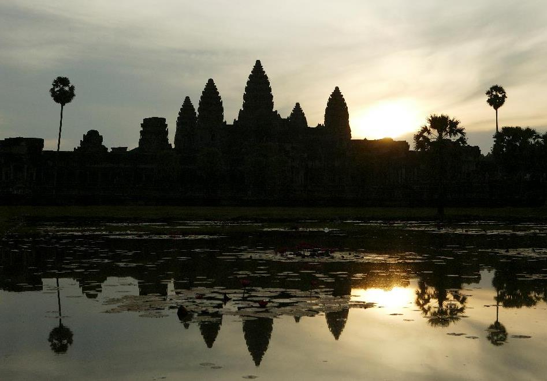
Where, and what, is Cambodia?
Source: Kochiro Nomoto/a.collection RF/Thinkstock

Slide 3
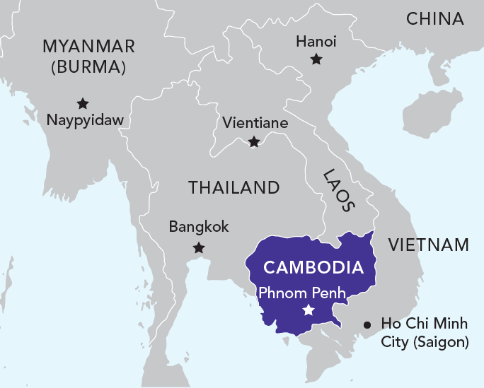
Where is Cambodia?
Where is Cambodia?
Mainland Southeast Asia
181,000 sq km
(BC 925,000 sq km)
15 million people today
7 million people in 1975
Notes:
NOTE: SIZE OF BC IS FOR LAND ONLY.

Slide 4
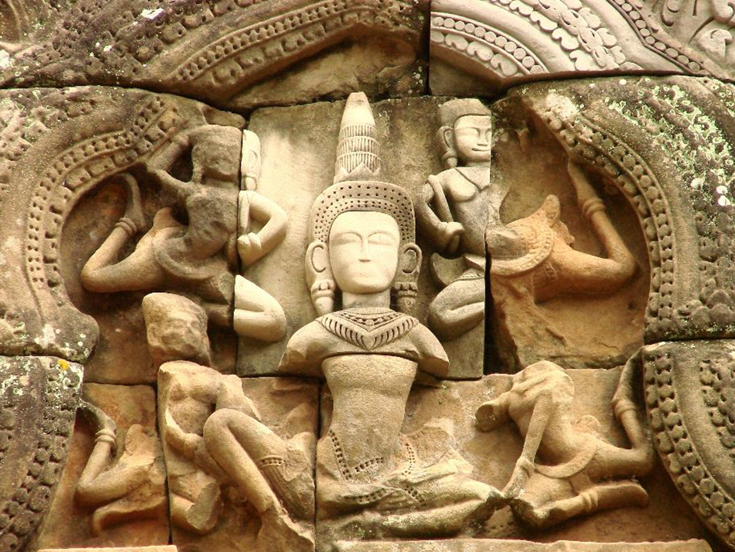
Land of spectacular temples
Angkor Wat
Angkorian period, ninth to 15th centuries
High point of Cambodian civilization
Photo by Adam Jones, Ph.D./Global Photo Archive/Flickr

Slide 5
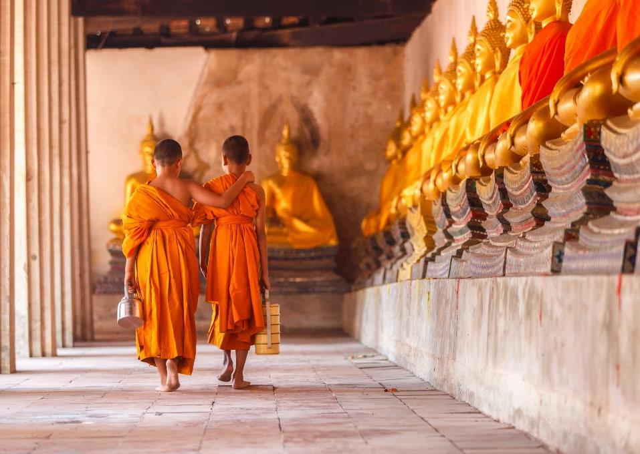
Land of Buddhism
Religion in Cambodia
Source: CIA World Factbook
Photo by Adam Jones, Ph.D./Global Photo Archive/Flickr
Notes:
Cambodia is a deeply Buddhist country – more than 90% of the country practices Buddhism
The Khmer Rouge targeted religious groups. At the start of 1975, there were an estimated 60,000 Buddhist Monks. At the end of their reign in 1979, only 3,000 were found alive.

Slide 6
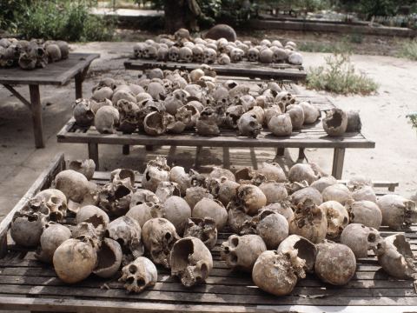
Land of the Killing Fields
From 1975 to 1979, two million Cambodians were executed, starved to death, or died of exhaustion or disease.
Their bodies were disposed in ”killing fields” around the country.
Source: AP Photo/Peter Stalder
Notes:
These were among the remains of nearly 2 million people who died during this four-year period.
They starved, were worked to exhaustion, or were executed under the Khmer Rouge

Slide 7
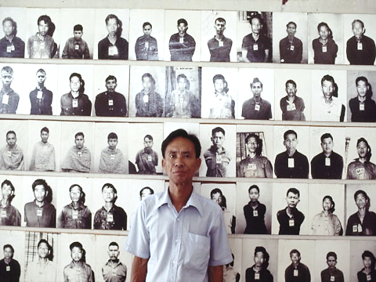
Land of survivors
Tuol Sleng Prison
An estimated 14,000 Cambodians were tortured and killed here.
Only seven people survived. This is one of them.
Source: David A. Harvey/National Geographic/Getty Images
Notes:
This photo was taken in 1981 at the Tuol Sleng museum. The museum was a school in the capital city of Phnom Penh that had been converted into centre for interrogation, torture, and execution by the Khmer Rouge. At that time it was called S-21 prison.
Many of the people tortured there were members of the Khmer Rouge who were suspected of disloyalty.
Prisoners had their photos taken before their deaths. In this picture, one of the survivors stands in front of these photos, which are now displayed in the museum.
Students can learn more by visiting the website at http://www.killingfieldsmuseum.com/.

Slide 8
Questions:
How and why did the Cambodian genocide happen?
How does it exemplify genocide under the United Nations genocide convention?

Slide 9
CAMBODIAN GENOCIDE: THE KILLING FIELDS
What role did colonization play in setting the stage for the rise of the Khmer Rouge?
How did Cambodia’s internal politics factor into the Khmer Rouge’s rise to power in 1975?
What role did external politics—especially global ideological conflict—play in the Cambodian genocide?

Slide 10
CAMBODIAN GENOCIDE: THE KILLING FIELDS
Who were the Khmer Rouge’s enemies? What methods did they use to purge them from the population?
In what ways does Cambodia from 1975-79 fit the UN’s 1948 definition of genocide?
The Cambodian genocide ended in 1979. What happened after that? What happened in terms of international geopolitics?

Slide 11
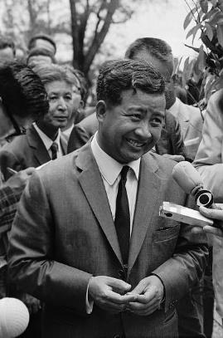
PRINCE NORODOM SIHANOUK
The “Chameleon King”
Prime Minister, 1954-70
Cosmopolitan, artistic, beloved by his people
…but corrupt, ruthless
Neutral in Cold War
…but gradually seen as favouring Vietnamese communists
Ousted in a coup in 1970
Source: Bettmann/Getty Images
Notes:
Cambodia became independent from France in 1954. In 1965 (midst of the Cold War) the U.S. government began sending troops to S. Vietnam to bolster against the communist threat.
Cambodia’s P.M. Sihanouk broke off relations with the U.S. and allowed communist North Vietnamese troops to be stationed within Cambodia.

Slide 12
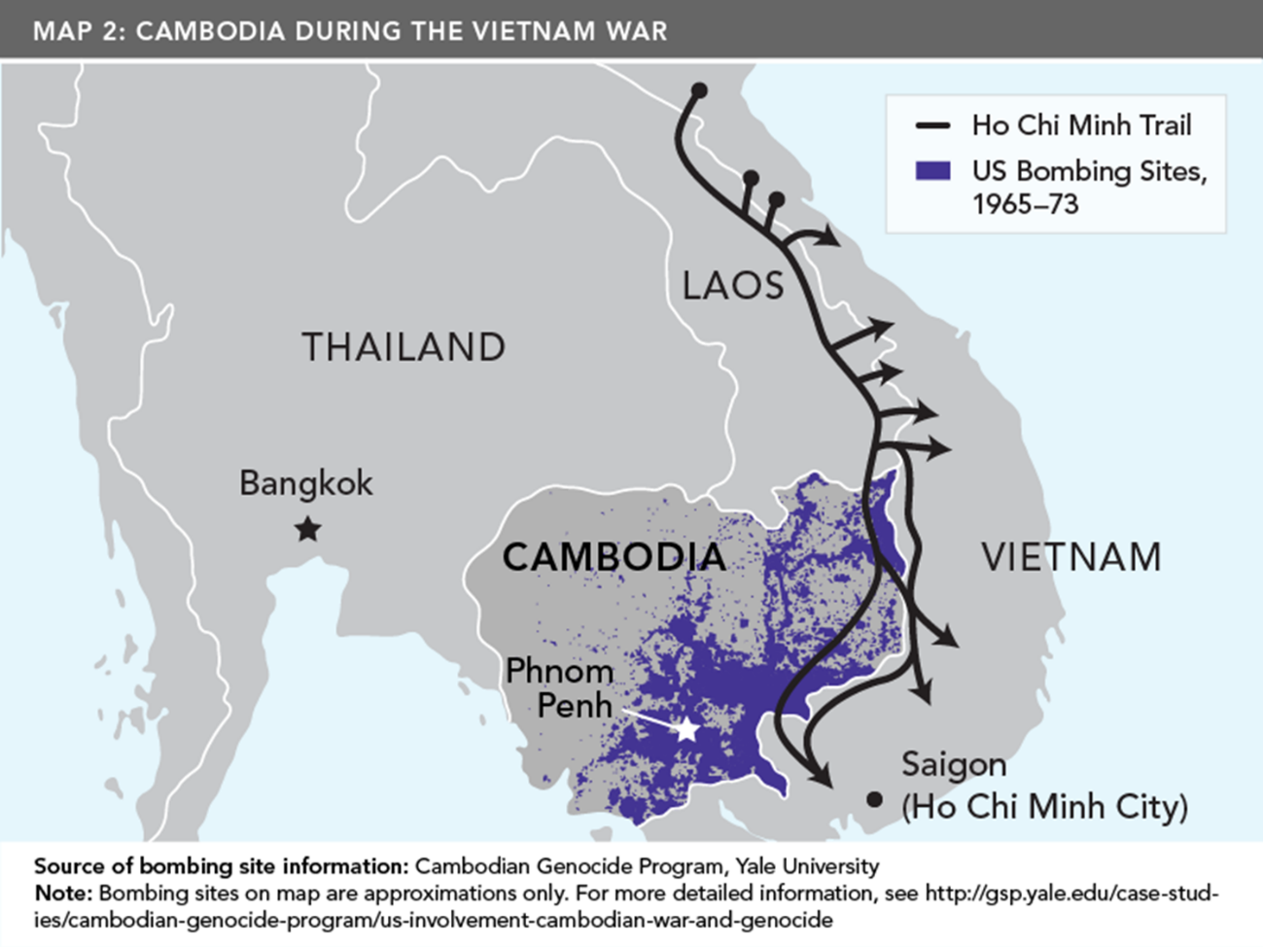
U.S. BOMBING, HO CHI MINH TRAIL

Slide 13
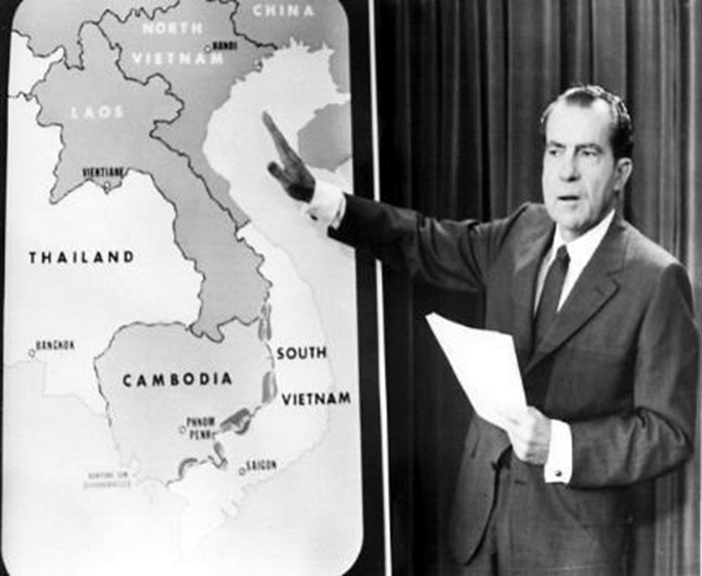
U.S. BOMBING OF CAMBODIA
U.S. President Richard Nixon
Operation Menu, 1969-70
Operation Freedom Deal, 1970-73
STF/AFP/Getty Images
Notes:
North Vietnam (communist) government using supply routes in eastern Cambodia.
U.S. responds by launching bombing campaign (Operation Menu) in 1969. (See picture of then new President Richard Nixon.)
Cambodian officials, led by General Lon Nol, favoured ties to the U.S. versus with communists. Lon Nol (with aid of the U.S.) overthrew Sihamouk in 1970.

Slide 14
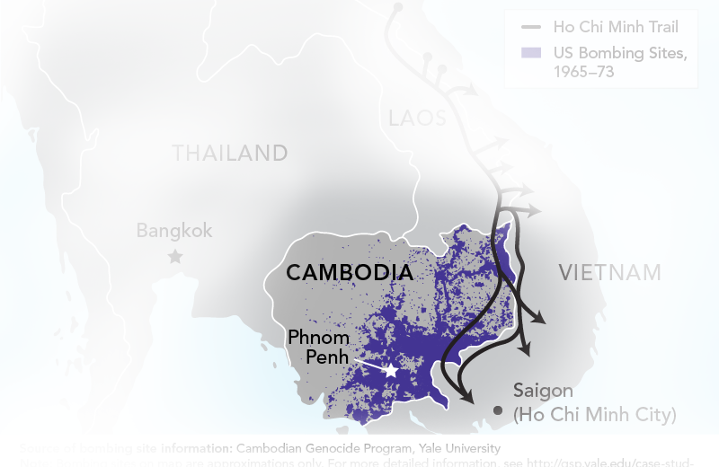
U.S. BOMBING OF CAMBODIA
2.7million
Tons of bombs U.S. dropped on Cambodia, 1965-73
2million
Tons of bombs Allies dropped in WWII

Slide 15
U.S. BOMBING OF CAMBODIA
150,000-500,000
Estimated number of deaths from U.S. bombing, 1965-73

Slide 16
U.S. BOMBING OF CAMBODIA
Impact of U.S. Bombing
“Civilian casualties in Cambodia drove an enraged populace into the arms of an insurgency that had enjoyed relatively little support until the bombing began, setting in motion the expansion of the Vietnam War deeper into Cambodia, a coup d’état in 1970, the rapid rise of the Khmer Rouge, and ultimately the Cambodian genocide.”
Source: Taylor Owen and Ben Kiernan, “Bombs over Cambodia,” The Walrus, October 2006, p. 63.

Slide 17
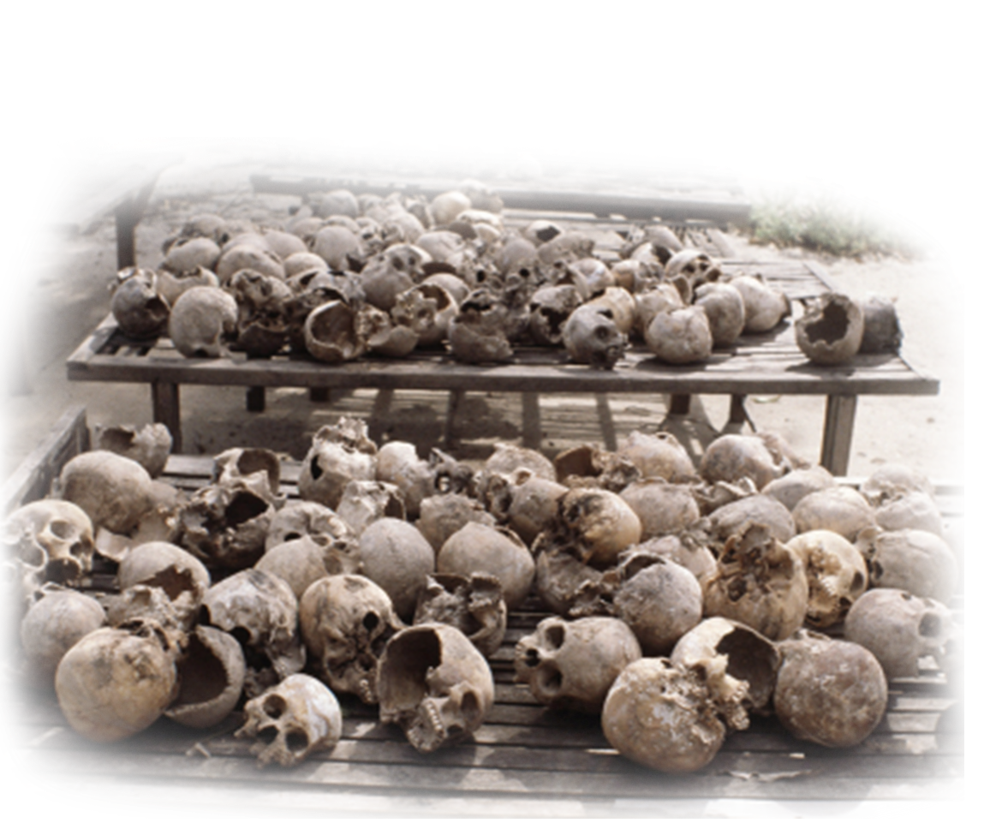
The Cambodian Genocide and the Killing Fields, 1975-79
Source: AP Photo/Peter Stalder

Slide 18
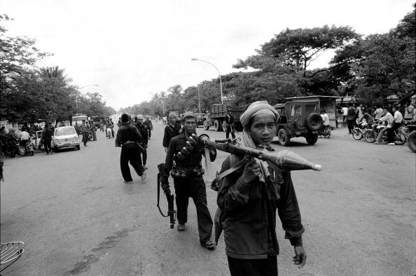
EVACUATION OF PHNOM PENH
Source: Roland Neveu/LightRocket via Getty Images
Notes:
Within hours of arriving in the capital, the KR set about rounding up its two million residents and deporting them to the countryside. Without damage to a single building, whole cities were destroyed. (Jones, p. 291) The peasantry were depicted as “base people” and the April 17th people, “new” people.

Slide 19
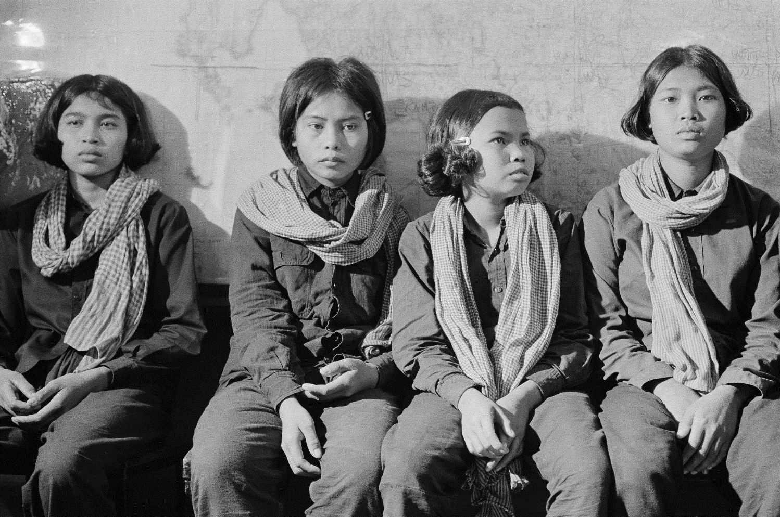
CAMBODIAN GENOCIDE
Who were the Khmer Rouge?
Source: AP Photo/Ly Ngan
Notes:
Many were young, rural, poor, uneducated. Some believed in the KR’s revolutionary ideas, though not necessarily its tactics. Some joined willingness; others were forced to join.

Slide 20
WHO WERE THE KHMER ROUGE?
Extremist communist party
Under the rule of Pol Pot known (original name: Saloth Sar)
Wanted to return Cambodia to the “Year Zero”
Responsible for the Cambodian genocide (1975 – 1979)
Notes:
All aspects of religious life, dissembling families, forcing people to work with their hands, and killing those suspected of being intellectuals, educated, or tied in any way to the leadership of the fallen Cambodian regime.
Class and political enemies, religious groups (of 60,000 Buddhist Monks, only 3,000 were found alive after the KR reign) and ethnic minorities fully 100% of ethnic Vietnamese perished under the KR, Muslim Chams, C.hinese, Thai

Slide 21
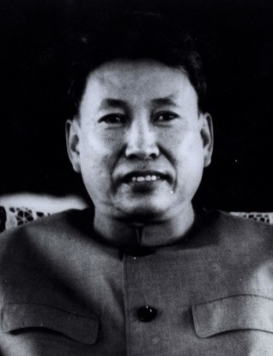
WHO WERE THE KHMER ROUGE?
Brother Number One: Pol Pot
“In their jungle camps the Khmer Rouge, led by Saloth Sar, born to a well to do family, rebranded himself Pol Pot, which means ‘original Cambodian,’ developed the philosophy that would guide their genocidal program and turn Cambodia ‘into our time’s arguably most murderous, brutal, inhuman small country.’”
Jones, p. 288 Goldhagen, Worse Than War
Universal History Archive/UIG via Getty images
Notes:
Pol Pot’s KR took control of the communist movement in 1966, and he created a communist ideology based on returning Cambodia to an idealized, pristine peasant society in which the corruption of modern life was to be eliminated.

Slide 22
WHO WERE THE KHMER ROUGE?
Pol Pot’s eight-point agenda to create utopian communist state
Evacuate people from the cities
Abolish all markets
Abolish all currency
Defrock all Buddhist monks
Execute the leaders of Lon Nol’s government and army
Establish cooperatives across Cambodia, with communal eating
Expel the entire ethnic Vietnamese population
Dispatch Khmer Rouge troops to the Thailand and Vietnam borders to secure the integrity of the revolution from encroachment from Cambodia’s traditional rivals

Slide 23
CAMBODIAN GENOCIDE: THE KILLING FIELDS
Pol Pot's Little Red Book: The Sayings of Angkar
Useless to argue, for the Angkor’s motives are perfectly pure!
Report everything to the Angkar!
When the Angkar tells you what to do, you do it!
Long live the revolutionary Angkar, utterly wise and clearsighted and ever glorious!
Absolutely everything belongs to the Angkar.
Be grateful to the Angkar!
The Angkar never uses any object from imperialist (American) or feudal society.
Notes:
From Henri Locard, Pol Pot’s Little Red Book: The Sayings of Angkar. Chiang Mai: Silkworm Books, 2004.

Slide 24
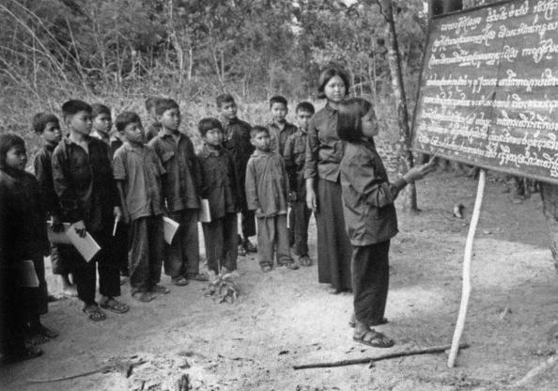
CAMBODIAN GENOCIDE: THE KILLING FIELDS
CAMBODIAN GENOCIDE: THE KILLING FIELDS
Source: Apic/Getty Images
Notes:
In the new Cambodia, the mysterious Angkar ruled everything and those with the shortest memories … children, were seen as the anchors of the new society. Angkar took Cambodia’s young away from their families and indoctrinated them as soldiers, laborers, spies and even executioners.
This photo is of children teaching/learning about agricultural methods.

Slide 25
S-21 SECRET PRISON
S-21 info and image

Slide 26
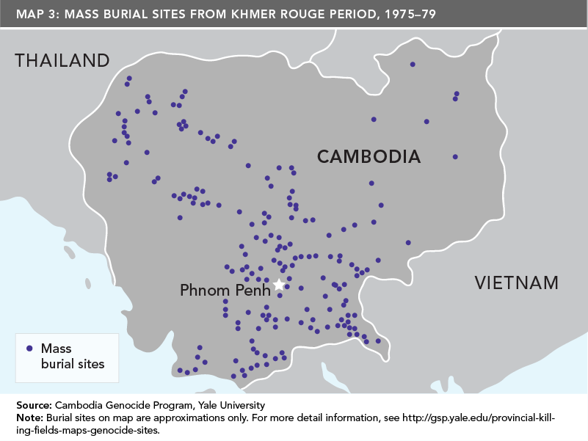
CAMBODIAN GENOCIDE: THE KILLING FIELDS

Slide 27
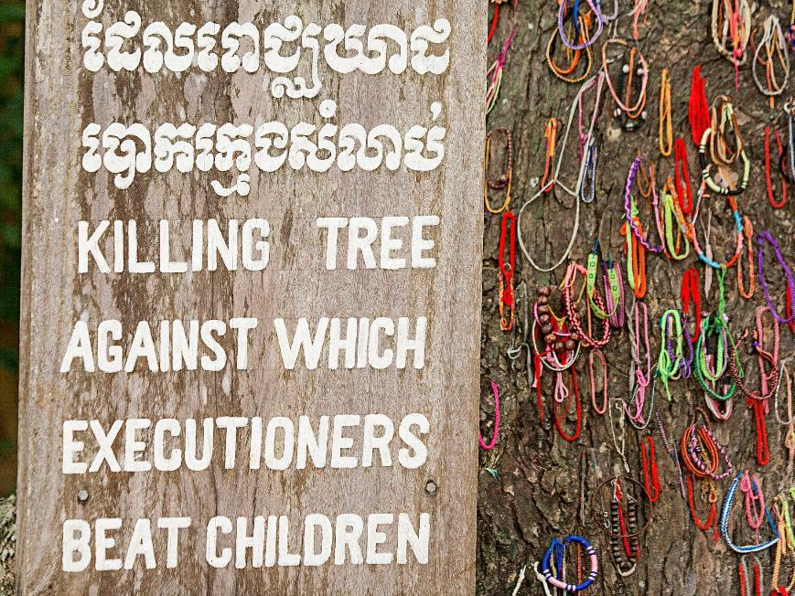
Post-1979: The Aftermath
Source: violinconcertono3/iStock/Thinkstock

Slide 28
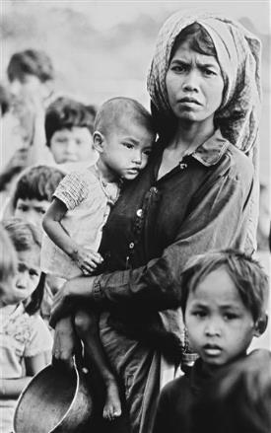
CAMBODIAN GENOCIDE: THE KILLING FIELDS
Thousands of refugees opposed to the Vietnamese occupation fled the country
Khmer Rouge soldiers did not surrender, but fled to Pailin near the border with Thailand
Source: AP Photo
Cambodian Refugees, 1979
Notes:
By 1977 and into 1978 the KR army, based on xenophobia, was invading Vietnamese territory, this would lead to open warfare between the two nations.
In December 1978 Vietnam invaded Cambodia, Cambodians had little motivation to defend the KR regime
The Vietnamese took Phnom Penh on January 7, 1979 and set up a pro – Vietnamese communist government called the People’s Republic of Kampuchea (made up of pro – Vietnamese communists who had deserted the KR in late 1970s)
This brought an end to Pol Pot’s rule, but he lived in the jungles where his KR originated and he never faced an independent trial before his fellow Cambodians nor an international tribunal.
Pol Pot died April 15, 1998

Slide 29
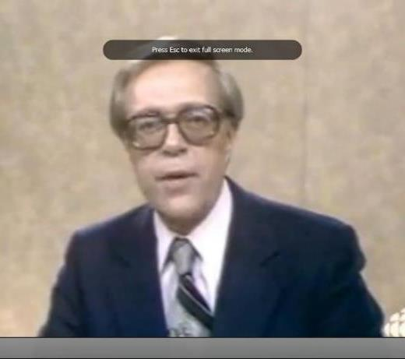
THE KILLING FIELDS
“Genocide and Famine in Cambodia”
CBC’s The National, October 16, 1979
“There’s no question that this is probably the worst tragedy that we have been faced with since the Second World War. There’s no question about it.”
George Weber, Canadian Red Cross
Notes:
Example of early international reporting about the genocide and famine
From CBC Archives, CBC’s The National, October 16, 1975, accessible at http://www.cbc.ca/archives/entry/genocide-and-famine-in-Cambodia.
Total video time 4:03 (you may need to watch a 30-second ad before that).
Includes short interviews with UNICEF Canada, Canadian Red Cross.

Slide 30
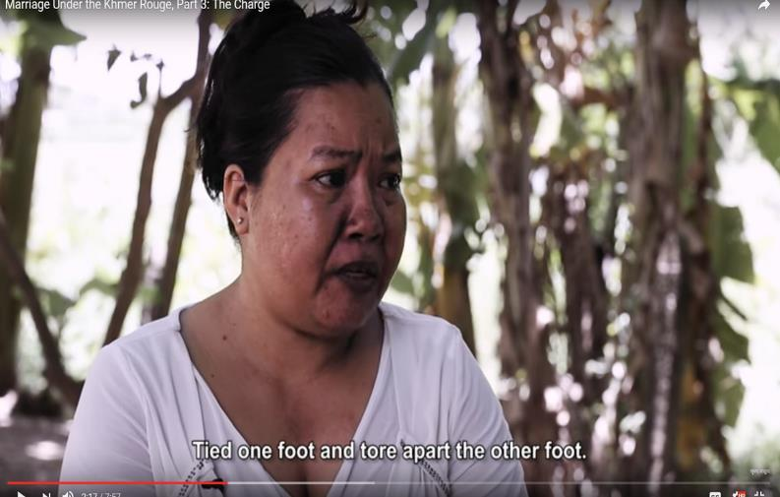
MARRIAGE UNDER THE KHMER ROUGE
Notes:
Part 3 of three-part series “Marriage under the Khmer Rouge” (time: 7:57)
Available at https://www.youtube.com/watch?v=wDFOo1xbr2Q

Slide 31
CAMBODIAN GENOCIDE: THE KILLING FIELDS
The Convention on the Prevention and Punishment of the Crime of Genocide (1948) defines genocide as any of the following acts committed with intent to destroy, in whole or in part,
a national, ethnical, racial or religious group:
Killing members of the group;
Causing serious bodily or mental harm to members of the group;
Deliberately inflicting on the group conditions of life calculated to bring about its physical destruction in whole or in part;
Imposing measures intended to prevent births within the group;
Forcibly transferring children of the group to another group.
Notes:
Based on what you have learned, in what ways was the 1975-79 period in Cambodia consistent with the definition of genocide?

Slide 32
Sources and References
Coloroso, Barbara. Extraordinary Evil: A Brief History of Genocide. Toronto, ON: Viking Canada, 2007. Print.
Hinton, Alexander Laban, Why Did They Kill? Cambodia in the Shadow of Genocide. Berkley, CA: University of California Press, 2005, p. 168
Jones, Adam. Genocide: A Comprehensive Introduction. London: Routledge, 2006. Locard, Henri. Pol Pot's Little Red Book: The Sayings of Angkar. Chiang Mai: Silkworm Books, 2004.
Ngor, Haing, Roger Warner, and Haing Ngor. Survival in the Killing Fields. New York: Carroll & Graf, 2003. Print.
Scream Bloody Murder. CNN. Christiane Amanpour. http://www.cnn.com/SPECIALS/2008/scream.bloody.murder/
Springer, Jane. Genocide. Toronto: Groundwood, 2006.
The Killing Fields. Dir. Roland Joffe. Perf. Sam Waterston and Dr. Haing S. Ngor. Warner Bros., 1985. DVD.
Totten, Samuel, Paul R. Bartrop, and Steven L. Jacobs. Dictionary of Genocide. Westport, CT: Greenwood, 2008.

