Slide 1


International
Cooperation
Image Set 1

Slide 2
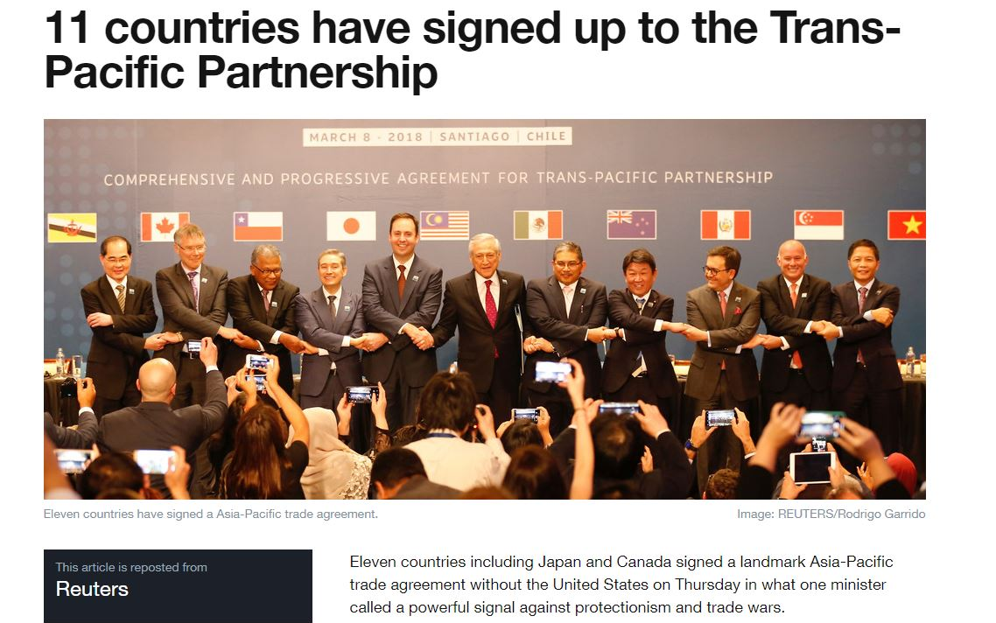
Large image
CPTPP – New Trans-Pacific Partnership Agreement Signed
Source: World Economic Forum / Reteurs
Notes:
In March 2018, eleven countries including Japan and Canada signed a landmark Asia-Pacific trade agreement without the United States. The Comprehensive and Progressive Agreement for Trans-Pacific Partnership (CPTPP) aims to reduce tariffs in countries that together amount to more than 13 percent of the global economy - a total of $10 trillion in gross domestic product.
For more information see: https://www.weforum.org/agenda/2018/03/11-countries-have-signed-trans-pacific-partnership

Slide 3
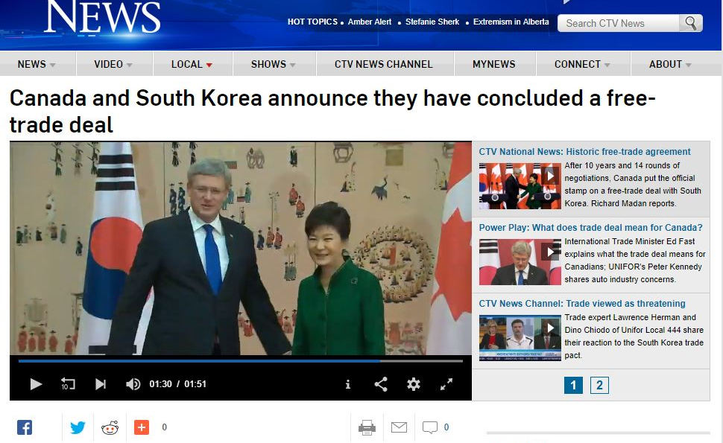
Large image
Canada, South Korea Sign Free Trade Agreement
Source: CTV News
Notes:
In 2014, Canadian Prime Minister Stephen Harper signed a free trade agreement with South Korean President Park Geun-hye, in what is considered a major boost for Canadian exporters looking to enter the Asia Pacific market. The Free Trade Agreement eliminated almost all tariffs between both countries and opened up markets such as the aerospace, pork and beef industries.
For more information see: https://www.ctvnews.ca/canada/canada-and-south-korea-announce-they-have-concluded-a-free-trade-deal-1.1723436

Slide 4

Large image
CPTPP: New trade deal gives Canadian businesses greater access to Asia-Pacific markets
“Our new Asia Pacific agreement is a bridge that will enable people, goods and services to be shared more easily with half a billion new customers. This latest agreement will make it easier for Canadian entrepreneurs to seize opportunities and create good, well-paying jobs for Canada’s middle class and those working hard to join it.”
- Jim Carr, Minister of International Trade Diversification
Minister Carr on the Canada’s New Trade Deal
Source: Government of Canada
Notes:
For more information see: https://www.canada.ca/en/global-affairs/news/2019/02/cptpp-new-trade-deal-gives-canadian-businesses-greater-access-to-asia-pacific-markets.html

Slide 5
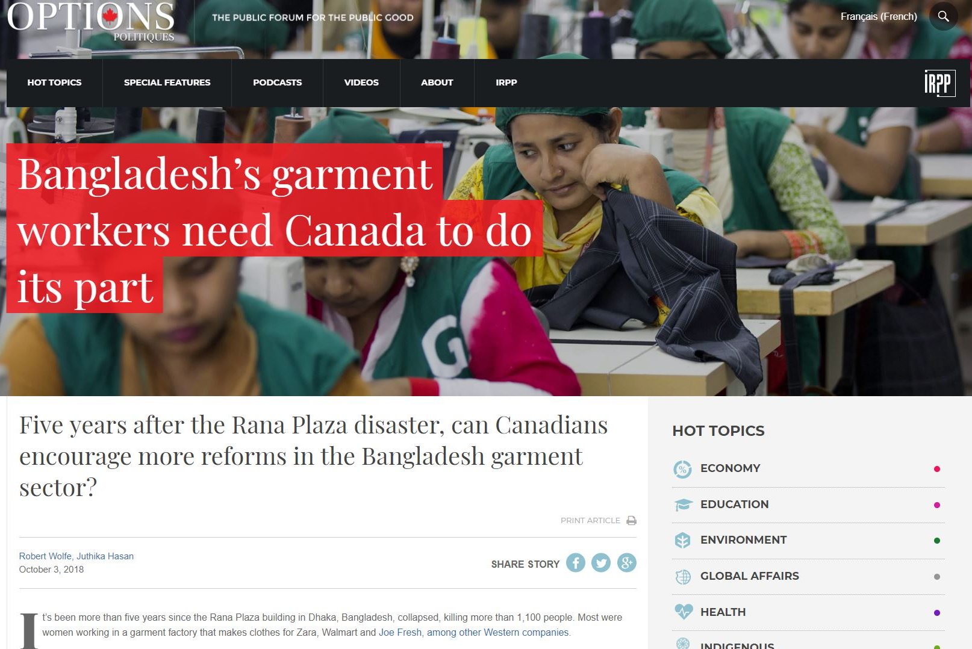
Large image
Factory Safety Rasies Question of International Cooperation
Source: Policy Options
Notes:
The Rana Plaza building accident in Bangladesh killed more than 1100 people in April 2013. The garment factory which produced clothes for Zara, Walmart and Joe Fresh, other Western companies was met with criticism for the poor conditions of workers. After the collapse of the building, the international community was fast to respond with collaborative efforts to improve working conditions. Canadians have encouraged reforms through activist pressure and legal action, including a court case in Ontario designed to force companies to abide by their voluntary corporate social responsibility commitments.
For more information, see: https://policyoptions.irpp.org/magazines/october-2018/bangladeshs-garment-workers-need-canada-to-do-its-part/

Slide 6
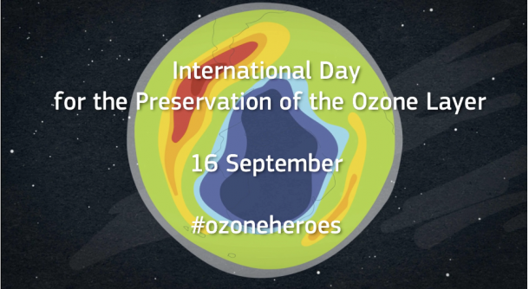
Large image
World Ozone Day: Keep Cool And Carry On
Source: World Meteorological Organization
Notes:
International Day for the Preservation of the Ozone Layer celebrates the progress in protecting the ozone layer and moves to phase out ozone depleting chemicals which are also potent greenhouse gases. This day also marks the anniversary of the Montreal Protocol on Substances that Deplete the Ozone Layer.
For more information see: https://public.wmo.int/en/media/news/world-ozone-day-keep-cool-and-carry

Slide 7
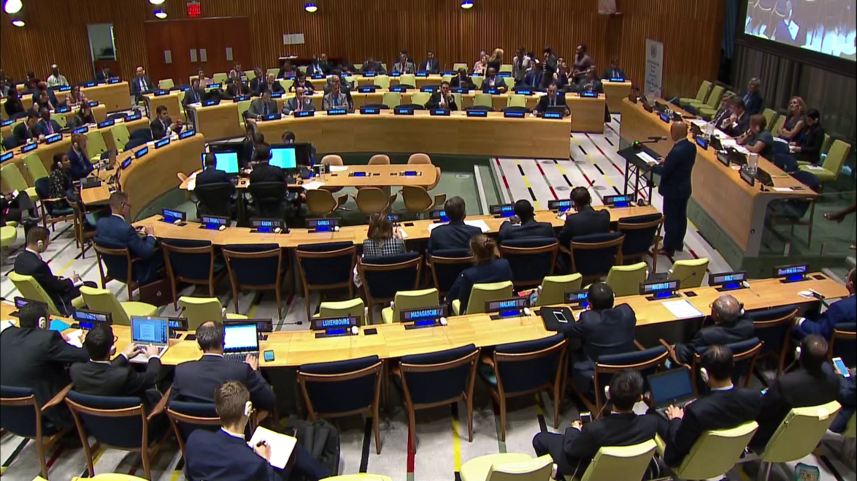
Large image
International Day for the Total Elimination of Nuclear Weapons
Source: United Nations Office for Disarmament Affairs
Notes:
Achieving global nuclear disarmament is one of the oldest goals of the United Nations. It was the subject of the General Assembly’s first resolution in 1946, which established the Atomic Energy Commission (dissolved in 1952). The International Day for the Total Elimination of Nuclear Weapons provides an occasion for the world community to reaffirm its commitment to global nuclear disarmament as a high priority. It provides an opportunity to educate the public - and their leaders - about the real benefits of eliminating such weapons, and the social and economic costs of perpetuating them.
For more information see: https://www.un.org/disarmament/update/international-day-for-the-total-elimination-of-nuclear-weapons-september-26/

Slide 8
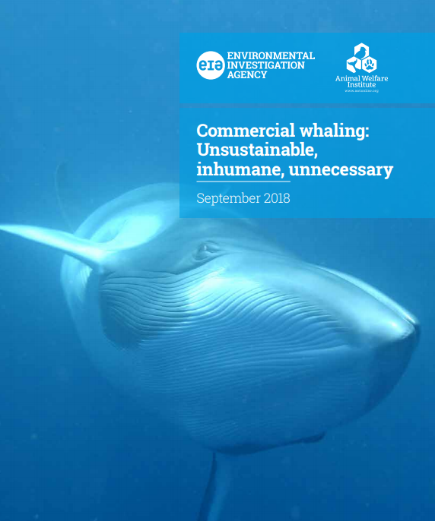
Large image
Petitions to Stop Whailing
Source: Environmental Investigation Agency
Notes:
An estimated 2.9 million whales were killed during the 20th century, leaving global whale populations decimated. The 1986 moratorium on commercial whaling enacted by the International Whaling Commission (IWC) saved several whale species from extinction and allowed some populations to recover. Despite the global ban, Japan, Norway and Iceland continue commercial whaling.
For more information see: https://eia-international.org/reports-mm/keeptheban/

Slide 9
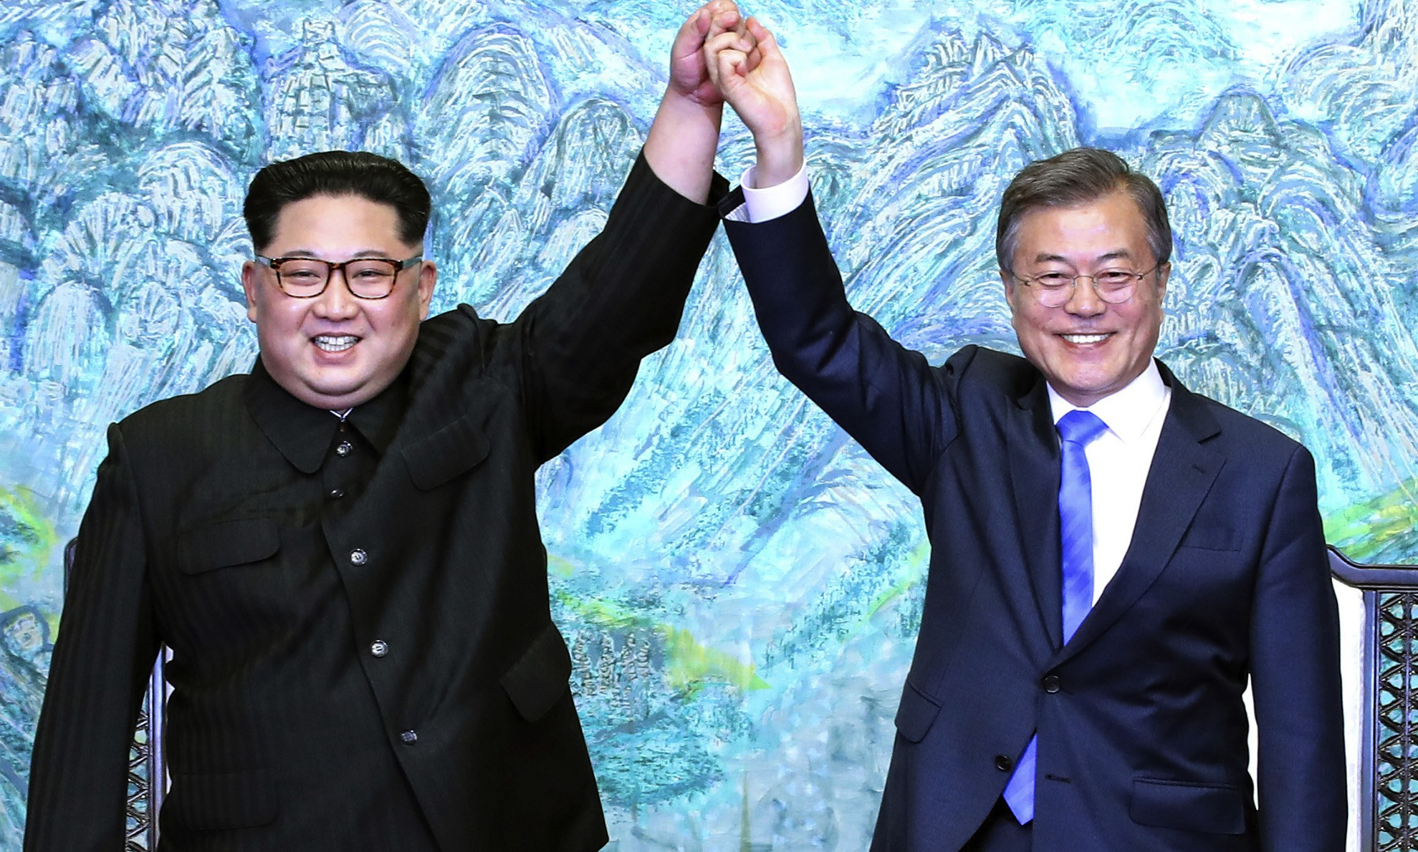
Large image
Kim Jong Un, Moon Jae-In meet at Inter-Korean Summit
Source: Washington Examiner/AP
Notes:
North Korean leader Kim Jong Un and South Korean President Moon Jae-In meet to discuss the denuclearization of the Korean peninsula on April 27, 2018. One year after the discussions, Pyongyang and Washington met at a second summit between US President Trump and Kim in Hanoi in February 2019.
For more information see: https://www.washingtonexaminer.com/news/moon-jae-in-faces-toughest-challenge-yet-in-third-summit-with-kim-jong-un
https://www.channelnewsasia.com/news/world/two-koreas-mark-moon-kim-summit-anniversary-with-different-tones-11483812

Slide 10
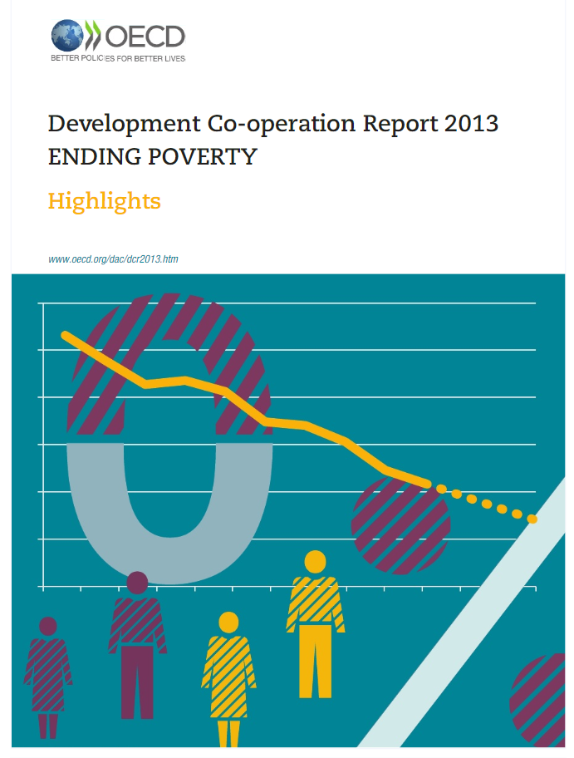

Large image
Ending Global Poverty
Sources: Organization for Economic Cooperation and Development (OECD)
Division for Social Policy and Development, United Nations
Notes:
October 17th is International Day for the Eradication of Poverty. A call to action put forth by the United Nations, the theme of the commemoration draws on the fight to end poverty. These values are also evident in the United Nations’ Agenda 2030 for Sustainable Development which sets poverty eradication as the overarching objective and obligated all countries to end poverty in all forms, through strategies that guarantee the fulfillment of all human rights and ensure no one is left behind.
For more information see: https://www.oecd-ilibrary.org/development/development-co-operation-report-2013/foreword_dcr-2013-1-en
http://www.aidforum.org/topics/food-security/international-day-for-the-eradication-of-poverty/

Slide 11
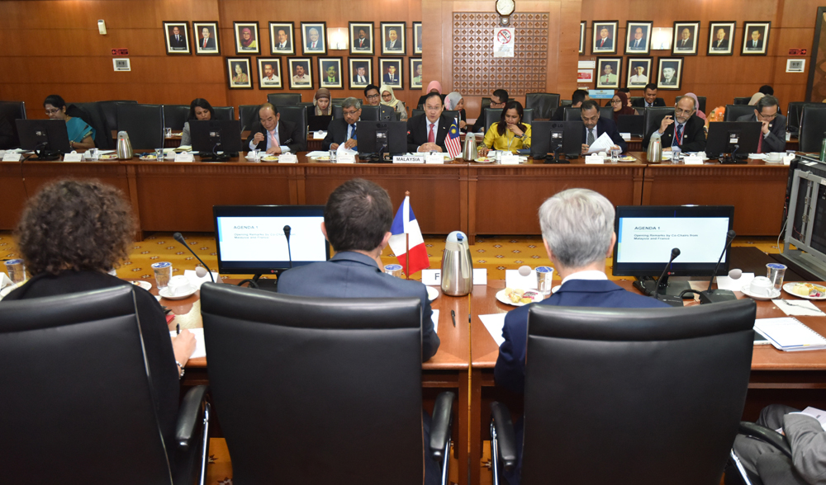
Large image
3rd Malaysia-France Joint Committee on Palm Oil Cooperation
Source: Ministry of Primary Industries, Malaysia
Notes:
The Ministry of Primary Industries chaired the 3rd Malaysia-France Joint Committee on Palm Oil Cooperation on April 4, 2019. These joint dialogues were created to strengthen engagements to promote better understanding of the palm oil industry.
For more information: https://www.mpi.gov.my/index.php/en/media-mpic-vbi/photo-gallery/mesyuarat-meeting/mesyuarat-3rd-malaysia-france-joint-committee-on-palm-oil-cooperation-my-fr-jcpoc-di-bilik-mesyuarat-nyatoh-kementerian-industri-utama

Slide 12
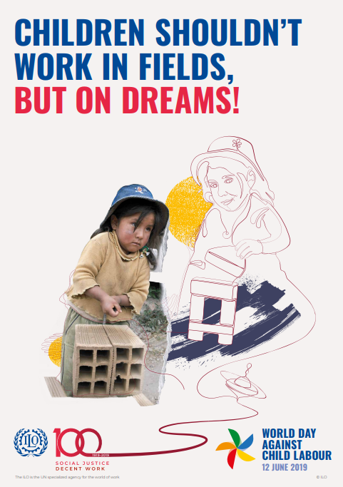
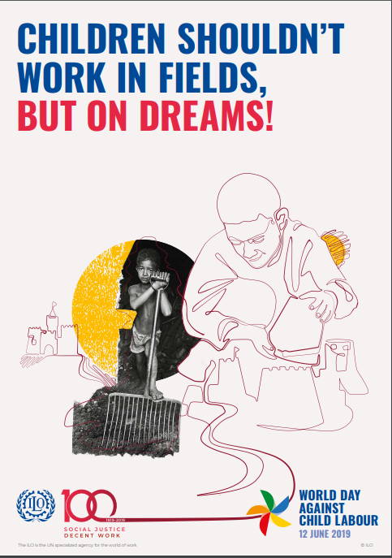
Large image
World Day Against Child Labour - 12 June 2019
Source: International Labour Organization
Notes:
In 2019 the International Labour Organization celebrates 100 years of advancing social justice. Since its founding in 1919, the protection of children has been embedded in the ILO’s Constitution. The World Day Against Child Labour also forwards the UN Sustainable Development Goal Target 8.7 set by the international community calling for an end to child labour in all its forms by 2025.
For more information see: https://www.ilo.org/ipec/Campaignandadvocacy/wdacl/lang--en/index.htm

Slide 13


International Cooperation
https://asiapacificcurriculum.ca/

