Slide 1
CHINA’S ONE-CHILD POLICY
Ms. Paget, West Vancouver Secondary

Slide 2
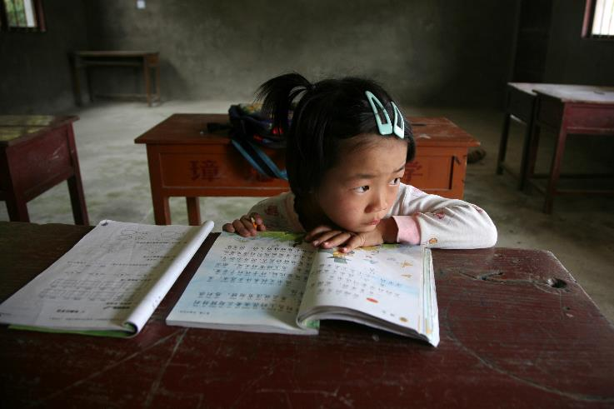
CHINA’S ONE-CHILD POLICY
REUTERS/Pillar Lee

Slide 3
CHINA’S ONE-CHILD POLICY
The One-child Policy was introduced by the Chinese government in 1979 to rapidly slow China’s population growth. Its immediate effect was to restrict
urban families to one child, and
rural families to one child if the first child is a boy, and two children if the first child is a girl.
The policy changed in early 2016 to allow Chinese couples to have two children.
The policy’s social and economic impacts have been wide-ranging and will shape China for decades to come.
Notes:
Note that there were some exceptions, primarily for ethnic minorities, who were allowed at least two children (and sometimes up to four).

Slide 4
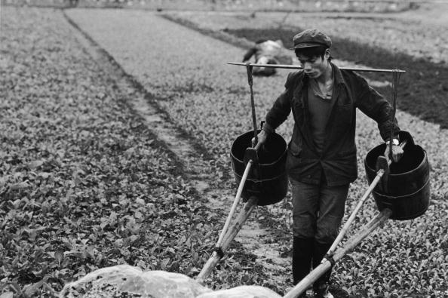
CHINA’S ONE-CHILD POLICY
Poor
China in 1979
80% rural
Poor
Large, young population
Linda Grove/Getty Images
Notes:
Sources: China’s population in 1980 is 80% rural: World Bank (http://data.worldbank.org/indicator/SP.RUR.TOTL.ZS?locations=CN). The rural population begins to decline rapidly that year.

Slide 5
CHINA’S ONE-CHILD POLICY
China’s Population Pyramid, 1960
MALE
FEMALE

Slide 6
CHINA’S ONE-CHILD POLICY
Economic growth: Canada, Japan, China: 1960-1979
Thousands (US$)
Source: World Bank

Slide 7
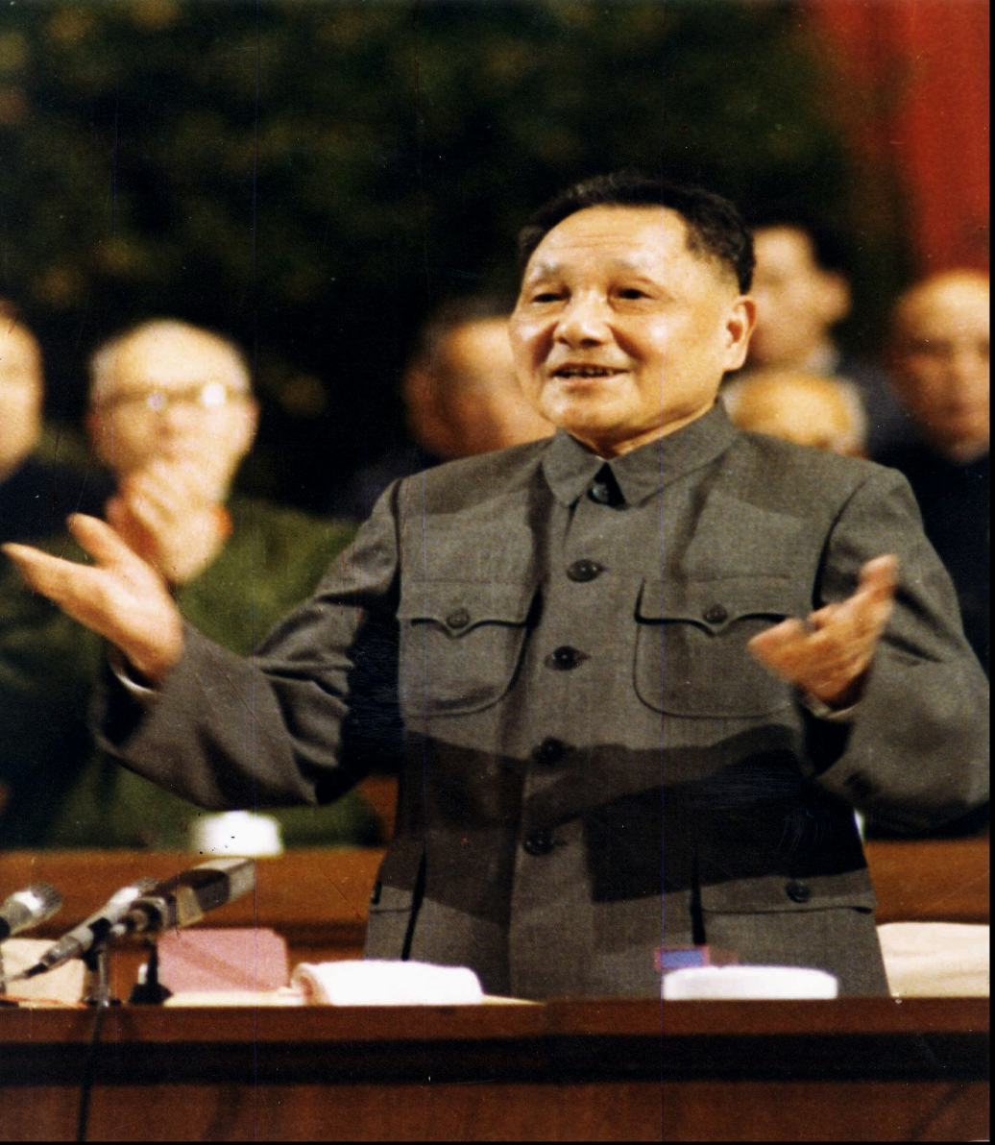
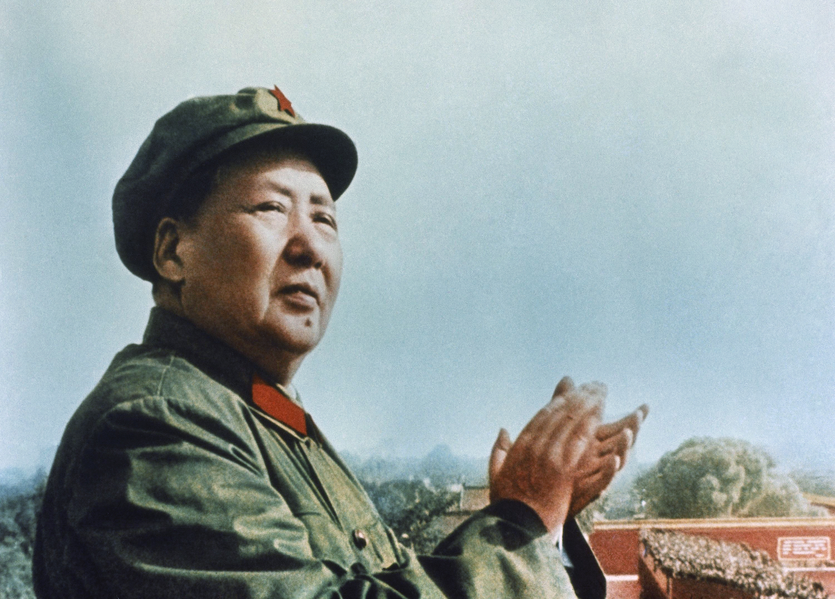
CHINA’S ONE-CHILD POLICY
1978 Leadership Change
Deng Xiaoping 1978-97
Pragmatic
“To get rich is glorious”
Mao Zedong 1949-76
Socialist ideology
Opposed pursuit of wealth
AP Photo
AP Photo/Xinhua
Notes:
In the interim period between Mao’s death in 1976 and Deng’s rise, there was a short-lived leader named Hua Guofeng.

Slide 8
CHINA’S ONE-CHILD POLICY
Belief that high population quantity would negatively impact population’s quality of life.
“If we do not implement planned population control and let the population increase uncontrollably, rapid population growth is bound to put a heavy burden on the state and the people, cripple the national economy, adversely affect accumulation and State construction, the people’s living standard and the their health, and slow down progress of the four modernisations.”
Editorial, People’s Daily, 8 July 1978

Slide 9
CHINA’S ONE-CHILD POLICY
Was the policy necessary?
One-child Policy introduced
Source: World Bank

Slide 10
CHINA’S ONE-CHILD POLICY
“Later, Longer, Fewer” campaign
Encouraged couples to
Wait longer to have their first child
Allow more time between the first and second child
Limit the number of children
Drove down the Total Fertility Rate from six children per woman in 1970 to 2.7 by the end of the decade, before the One-child Policy was introduced.

Slide 11
CHINA’S ONE-CHILD POLICY
Discussion
Why was China’s population growth decreasing before the One-child Policy was introduced?
If population growth was already slowing, why did the Chinese government still think the policy was necessary?
Could the Chinese government have known that trends would continue without the policy?
Why do you think the government kept the policy in place as long as they did?
Notes:
Discussion questions

Slide 12
CHINA’S ONE-CHILD POLICY
Why was the fertility rate slowing?
Urbanization
Move from the countryside to cities
Eliminates need for big families to help with farm work
Education of women
Formal education = jobs outside the home
Large families less practical
Family planning policies
Government encouraged couples to have smaller families starting in early 1970s

Slide 13
CHINA’S ONE-CHILD POLICY
Propaganda
The Chinese government put considerable effort into promoting the ideal of the one-child nuclear family, which now has become the norm.
View the propaganda posters (next slides) and as a class, discuss the following:
What message are the posters trying to convey?
Who is the propaganda trying to convince?
What techniques are they using to convince Chinese people that the One-child Policy is a good thing?

Slide 14
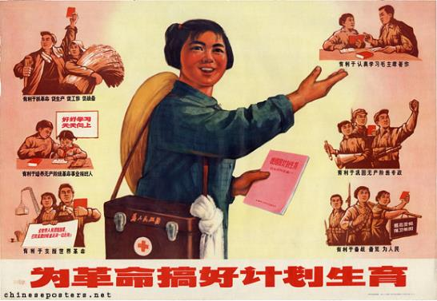
CHINA’S ONE-CHILD POLICY
“Practice birth control for the revolution” (1972)
Designer: Revolutionary Committee of Shanghai Municipal Health Office, May 1972
(www.chineseposters.net)
Notes:
Designer: Revolutionary Committee of Shanghai Municipal Health Office (上海市卫生局革委会供稿)
1972, May
Practice birth control for the revolution
Wei geming gaohao jihua shengyu (为革命搞好计划生育)

Slide 15
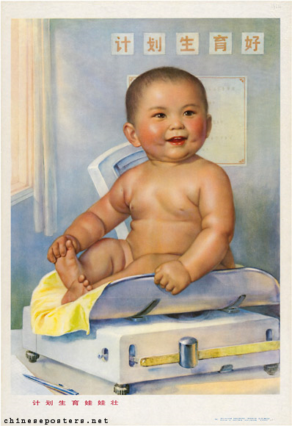
CHINA’S ONE-CHILD POLICY
“Children born under planned parenthood are strong” (1978)
Designer: Li Mubai (李慕百)
April 1978
(www.chineseposters.net)
Notes:
Designer: Li Mubai (李慕百)
1978, April
Children born under planned parenthood are strong
Jihua shengyu wawa zhuang (计划生育娃娃壮)

Slide 16
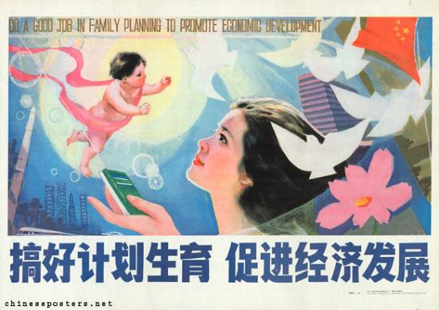
CHINA’S ONE-CHILD POLICY
“Do a good job in family planning to promote economic development” (1986)
Designer: Zhang Zhenhua (张振华)
April 1986 (www.chineseposters.net)
Notes:
Designer: Zhang Zhenhua (张振华)
1986, April
Do a good job in family planning to promote economic development
Gaohao jihua shengyu, cujin jingji fazhan (搞好计划生育促进经济发展)
http://chineseposters.net/themes/population-policy-2.php: Western bridal clothes were not the only indication that the people's livelihood was improving. Various elements of economic development started to creep into the more traditional poster-design. This started with highrise buildings in the background, and ended with the use of Western imagery: space ships, atomic symbols, even remote controls. The visual element that many of these posters have in common is the dove; this bird is not presented as the traditional emblem of long life, but as the internationally accepted icon of peace.

Slide 17

CHINA’S ONE-CHILD POLICY
Modern-day propaganda
REUTERS/Guang Niu

Slide 18
CHINA’S ONE-CHILD POLICY
Incentives for compliance
Monthly cash payments
Preference in housing allocations
Preference in job assignments
Free medical care
Free schooling, priority registration at preferred schools
Notes:
The incentives

Slide 19
CHINA’S ONE-CHILD POLICY
Enforcement, punishments for non-compliance
Parents’ salary could be reduced, damage to careers
No additional housing space for additional family members
Parents bear the cost of child’s birth, medical care, schooling
No access to other social welfare through hukou (“household registration”)
“Black children” / “hidden children”
Notes:
The Punishments

Slide 20
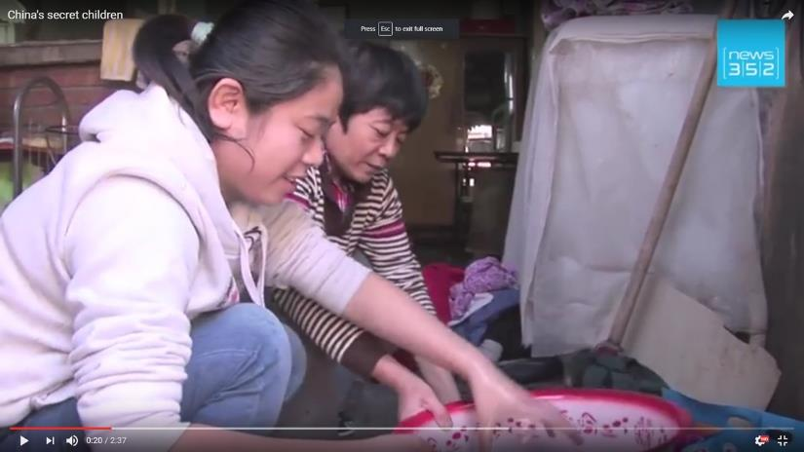
CHINA’S ONE-CHILD POLICY
“China’s secret children,” News 322
Notes:
https://www.youtube.com/watch?v=j4-S_Oqq4lI

Slide 21
CHINA’S ONE-CHILD POLICY
“A lot of experts do believe the one-child policy helped the Chinese to improve their living standards, especially back in the '80s, when China was facing the shortage of food and water supply in the late '70s and early '80s.”
Professor Meirong Liu
Listen to the full interview at “How China’s Families Were Impacted by China’s One-Child Policy,” NPR, All Things Considered, October 31, 2015,
www.npr.org/2015/10/31/453509914/how-familes-were-impacted-by-chinas-one-child-policy.
Notes:
Pronunciation Note: Meirong Liu = MAY-wrong Lee-OH (the interviewer mispronounces it).
Interview length is 2:37, and may be preceded by a short (15-second) ad.
Hyperlink: http://www.npr.org/2015/10/31/453509914/how-familes-were-impacted-by-chinas-one-child-policy

Slide 22
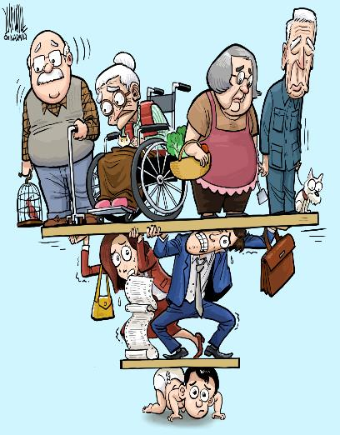
CHINA’S ONE-CHILD POLICY
The Consequences
“4-2-1 Problem”
Elderly Rights Law (2013)
“4-2-1 Problem”
“Elderly Rights Law” (2013)
Copyright @Luojie, 2013 (Cagle Cartoons)

Slide 23
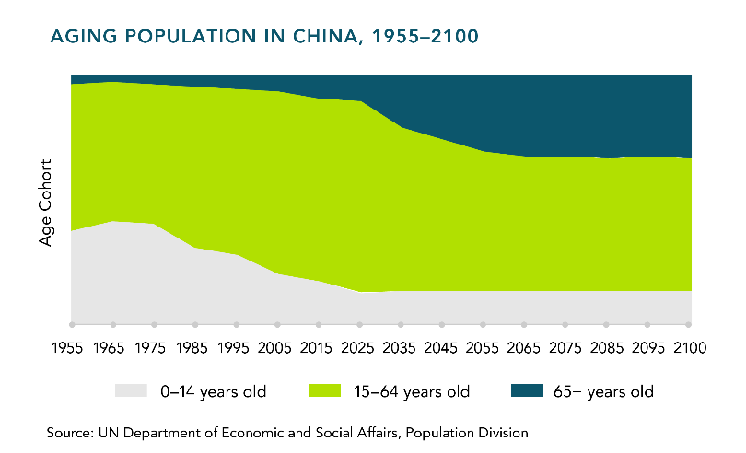
CHINA’S ONE-CHILD POLICY

Slide 24
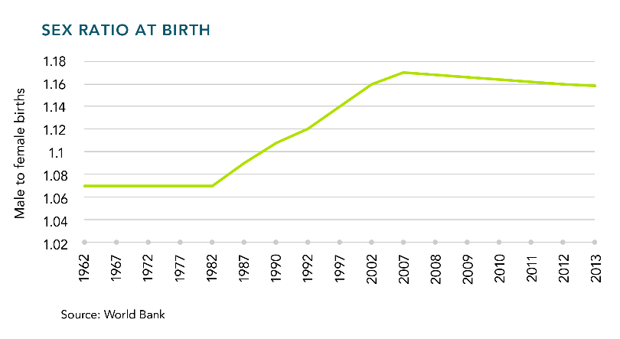
CHINA’S ONE-CHILD POLICY
The Consequences: Undesirability of Girls
Notes:
Consequences: Gender imbalance

Slide 25
CHINA’S ONE-CHILD POLICY
Critique: An opinion
Women now feel financial and physical responsibility for their parents in the absence of (male) siblings and have therefore entered the workforce in greater numbers and arranged their marriages (where they have greater power as a result of the lack of females) to accommodate the care of their parents
As a result of shorter child-bearing and child-rearing time periods, more women enter the labour force and pursue advanced education, increasing their power inside the home and in society.
Source: Kristine Sudbeck, The Effects of China’s One-Child Policy: The Significance of Chinese Women, University of Nebraska-Lincoln, 2012.

Slide 26
CHINA’S ONE-CHILD POLICY
Changing policy?
“For some time in the future, China’s basic national condition of a large population will not fundamentally change. It will continue to put pressure on economic and social development. Tensions between the size of the population and the resources and environment will not fundamentally change.”
“Xi says family planning to remain a long-term policy,”
Global Times, May 19, 2016

Slide 27
CHINA’S ONE-CHILD POLICY
Why the change in policy might not change things
Cost of living
Lack of living space
Cost of children’s education
Parents’ career incompatible with time required to raise a second child
Bought into belief that small families are an ideal in China’s modernization and socio-economic progress.

Slide 28
CHINA’S ONE-CHILD POLICY
Expectation inflation
Consequences
“Little Emperor” syndrome
But also…
Pressure for only child to succeed (heavy investment of time, money from parents).
Consequences of an under-performing, under-earning child?
Consequences of having a physically or mentally challenged child? (Consequences for the parents? For the child?)
“Society is a contest where people eat people”
Source: Vanessa Fong, Only Hope: Coming of Age under China’s One-child Policy, Stanford: Stanford University Press, 2004.
Notes:
Expectation inflation

Slide 29
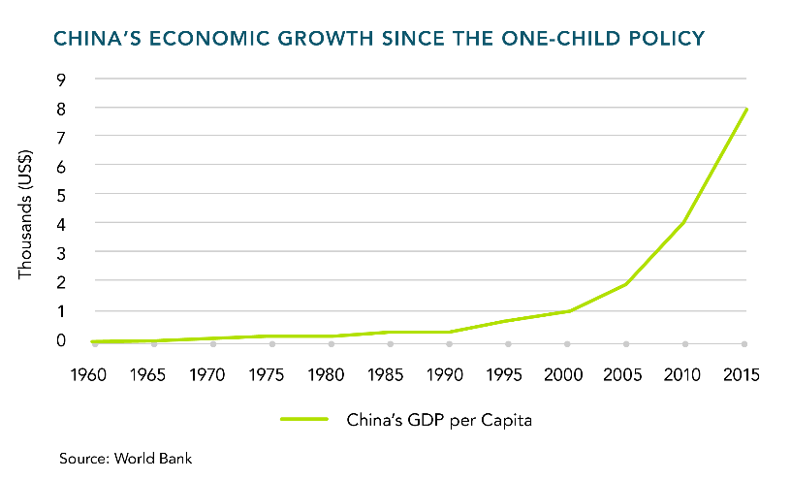
CHINA’S ONE-CHILD POLICY

Slide 30
CHINA’S ONE-CHILD POLICY
Population pyramids
Graph that shows age-sex distribution of a given population. Sex is displayed on horizontal (x-axis) line, and the percentage of population on the vertical (y-axis) line. Each grouping (e.g., males aged 0-4) is called a cohort.
Demographers use population pyramids to see population trends in the past, examine the current resident profile, and also project how the population will increase or decrease in the future.

Slide 31
CHINA’S ONE-CHILD POLICY
Analysis of population pyramids?
The more rectangular the graph, the more slowly a population is growing. We see a more uniform population size across age groups, with older generations being replaced by new generations of approximately the same size.
The more a graph looks like a pyramid, the faster that population is growing; older generations are producing larger younger generations.
Another way to think about it is that the pyramid shape with a larger bottom than top has a higher percentage of the population in the reproductive years or younger, giving that population greater potential for growth.

Slide 32
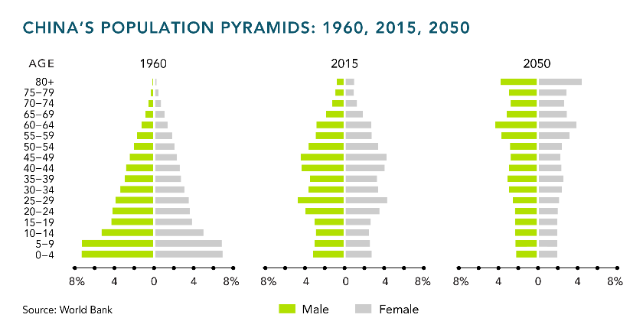
CHINA’S ONE-CHILD POLICY

Slide 33
THE END

