Slide 1
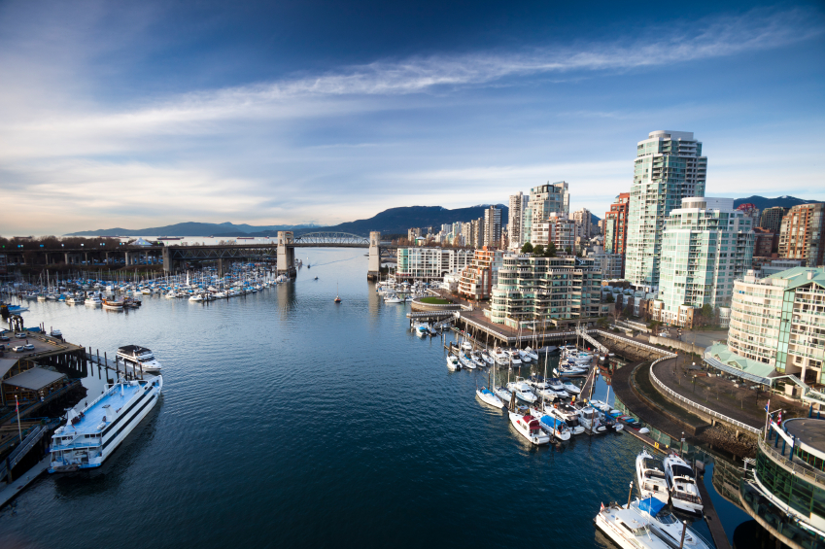


Urbanization in Canada

Slide 2
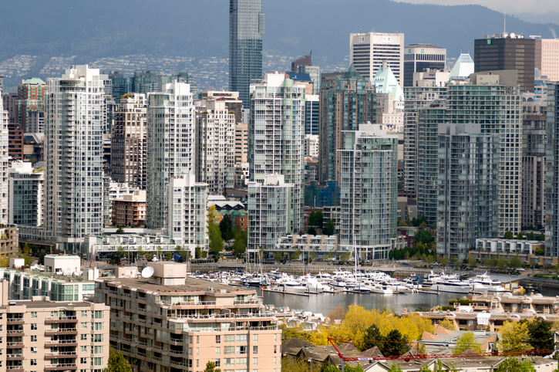
Waterfront condo towers in Downtown Vancouver
Source: Stuart McCall/Getty Images

Slide 3
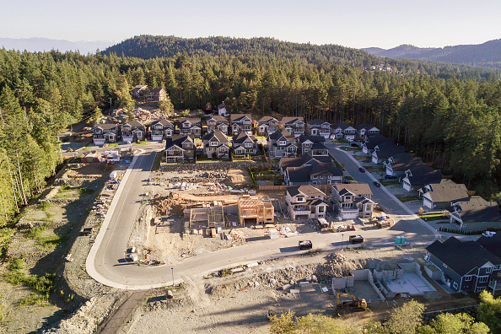
New housing construction in Victoria, BC.
Source: Bloomberg/Contributor/Getty Imagesz

Slide 4
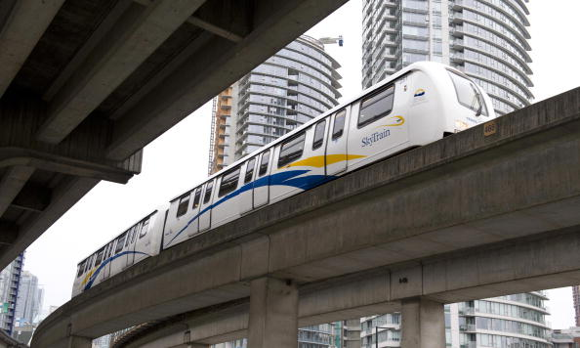
Skytrain passes near Canada Hockey Place. The Skytrain is Vancouver’s light rail system.
Source: DON EMMERT/AFP/Getty Images

Slide 5

Urban designers working with swatches and a laptop.
Source: Hero Images/Getty Images

Slide 6
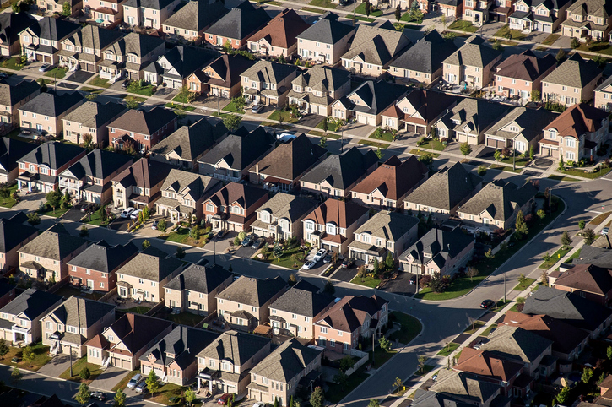
Neighborhood in Toronto, Ontario.
Source:: James MacDonald/Bloomberg/Getty Images

Slide 7
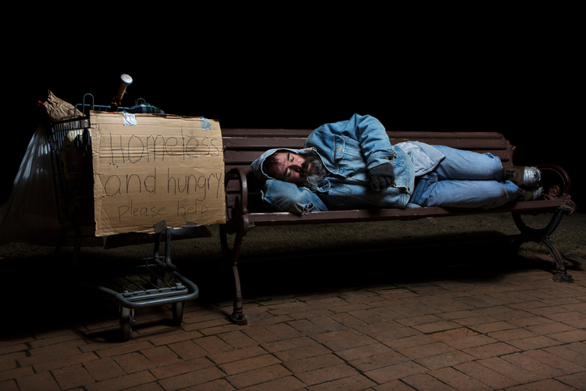
Homeless man at night sleeping on a park bench with his shopping cart full of his possessions.
Source: Steve Mcsweeny/Getty Images

Slide 8
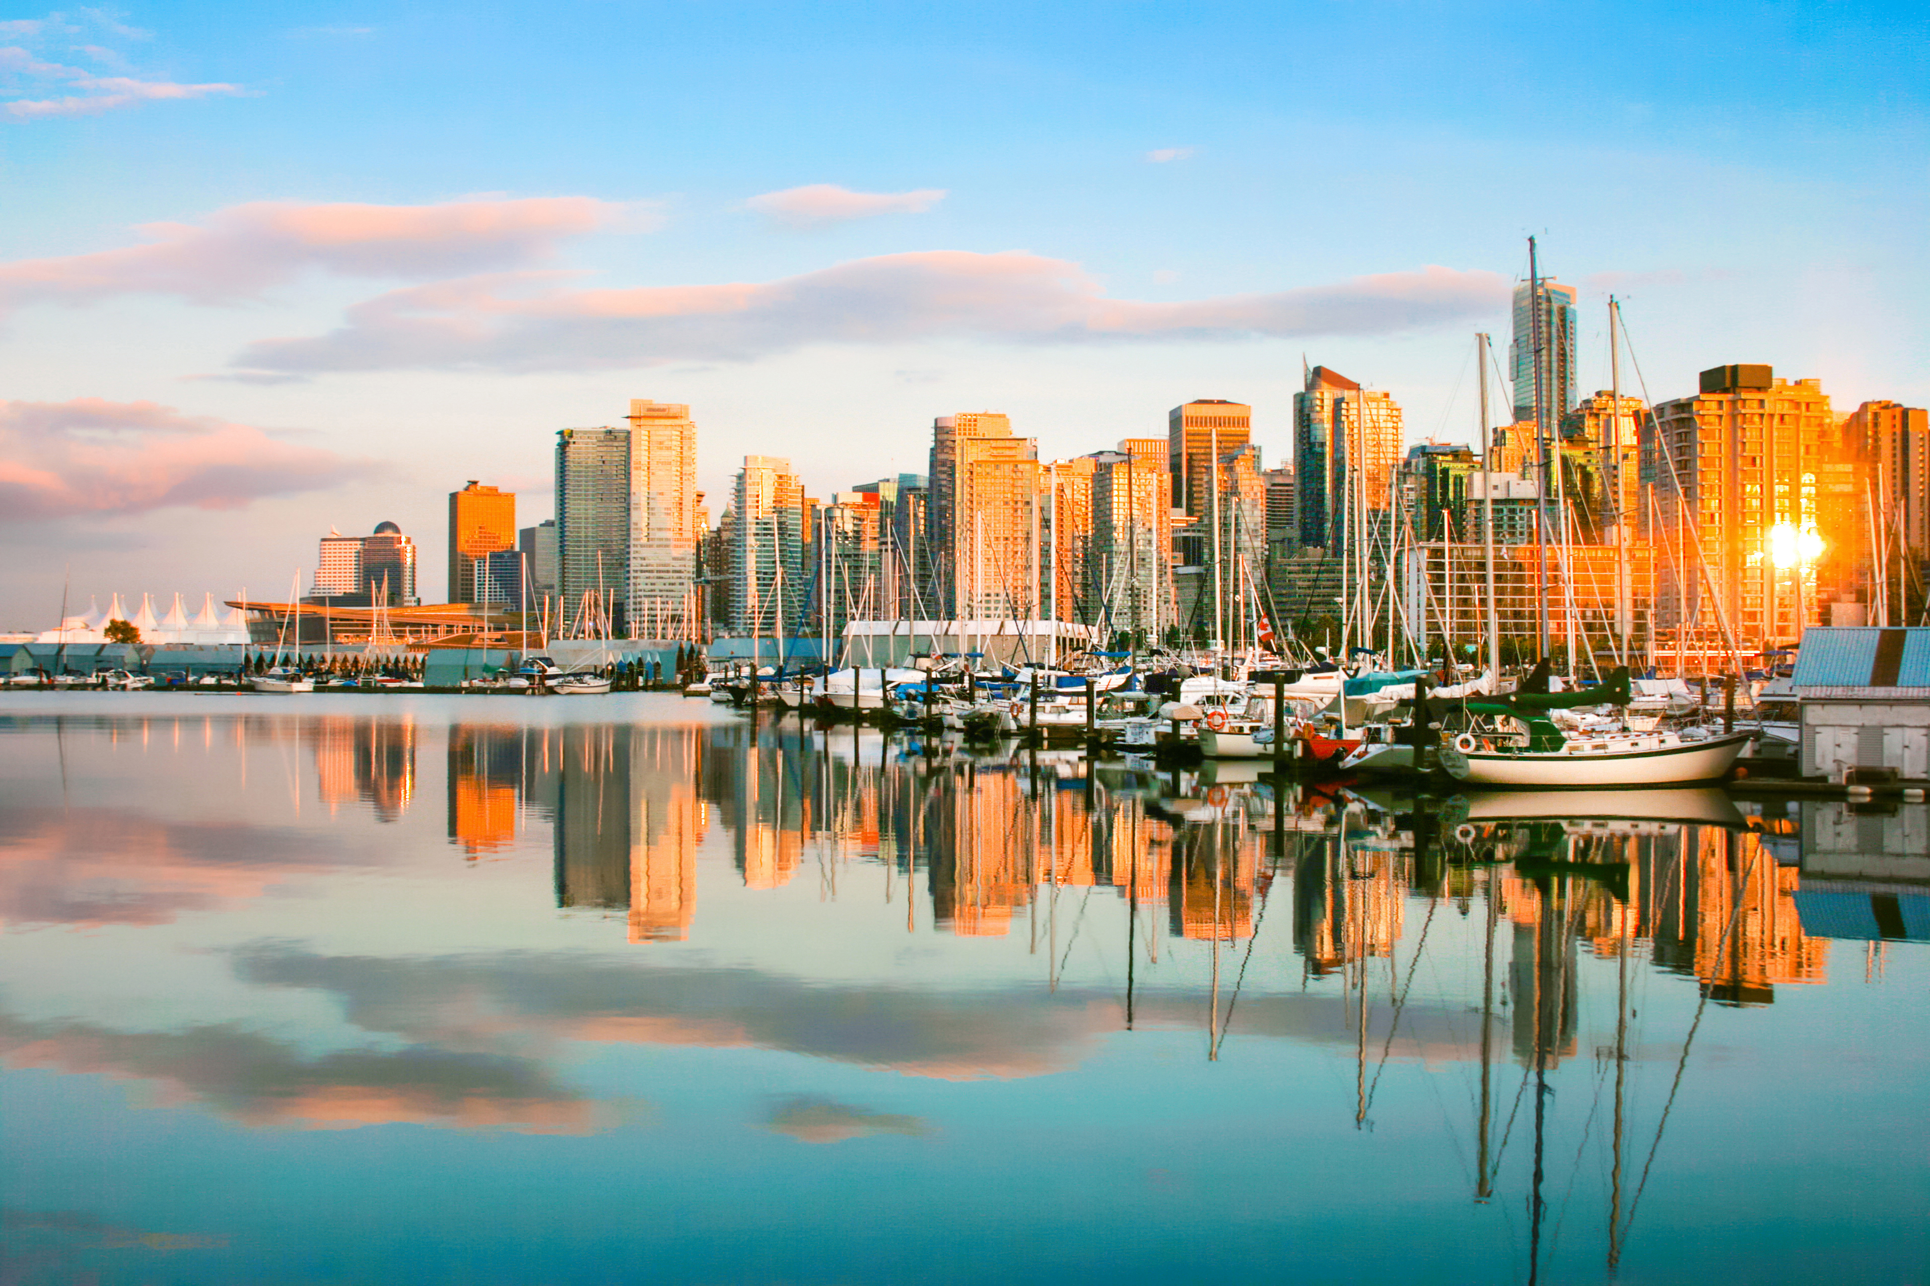
The Asia Pacific Curriculum project is being undertaken in partnership with the British Columbia (B.C.) Ministry of Education
More curriculum resources available at: https://asiapacificcurriculum.ca/

