Slide 1

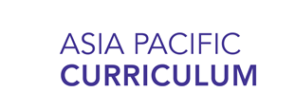
Urbanization in Asia
Image Set 1

Slide 2
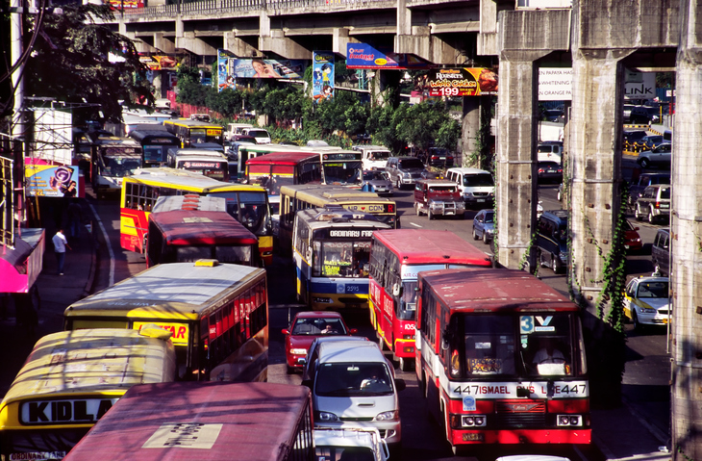
Large image
Traffic in Manila, Philippines
Source: Apexphotos/Getty Images
Notes:
Manila, the Philippines, Epifanio de los Santos Avenue, inevitably and colloquially referred to by its acronym EDSA, is the main ring road of Manila, the capital city of the Philippines Congested since it opened in 1940, it is a place of madness, continuous traffic jams and pollution.

Slide 3
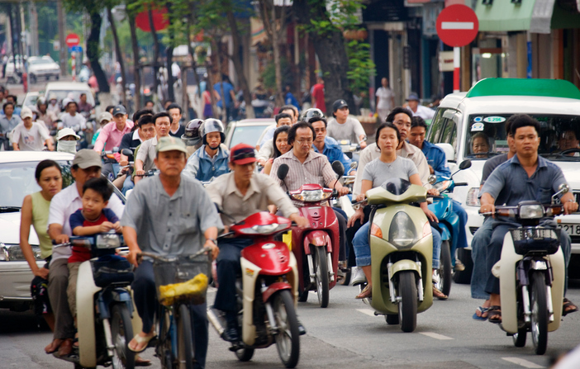
Large image
Motorbike Traffic in Ho Chi Minh City, Vietnam
Source: David Buffington/Getty Images
Notes:
People riding motorbikes in Ho Chi Minh City, Vietnam
Source: David Buffington/Getty Images

Slide 4
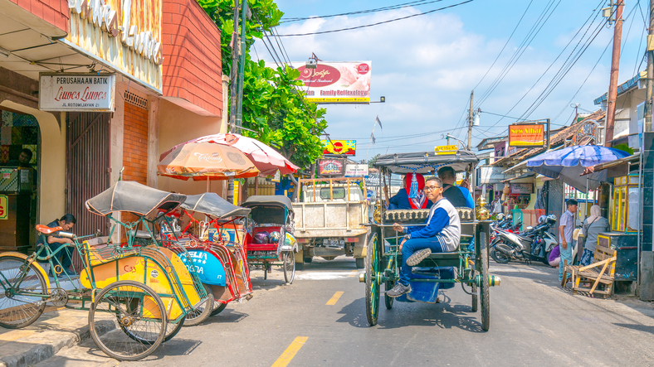
Large image
Becak (Three-wheeled Bike) in Yogyarta, Indonesia
Source: simonlong/Getty Images
Notes:
Three-wheeled bikes (becak) in Yogyakarta, Indonesia.

Slide 5
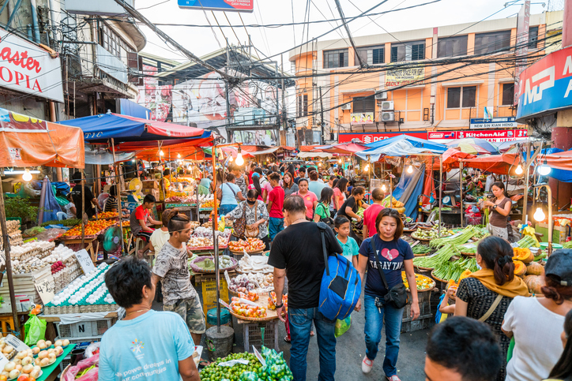
Large image
Street Market in Manila, Philippines
Source: holgs/Getty Images
Notes:
Various kinds of fruits and vegetables being sold in the middle of the busy streets of Quiapo in Manila, Philippines. People can be seen walking around.

Slide 6
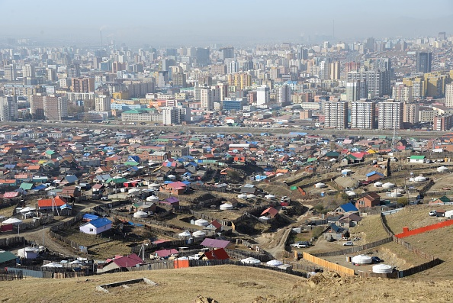
Large image
Urban Ger District in Ulaan Baatar, Mongolia
Source: Didem Tali/SOPA Images/LightRocket via Getty Images
Notes:
Extreme winter temperatures, poor infrastructure, and urban sprawl create one of the world’s worse cases of air pollution in the Mongolian capital of Ulaan Baatar.

Slide 7
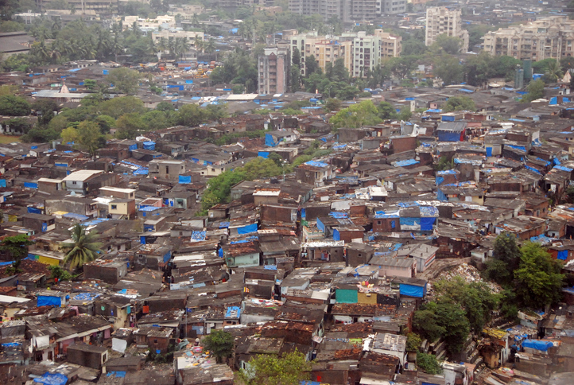
Large image
Dharavi Slum in Mumbai, India
Source: Paul Biris/Getty Images
Notes:
View of Dharavi slum in Mumbai, India.

Slide 8
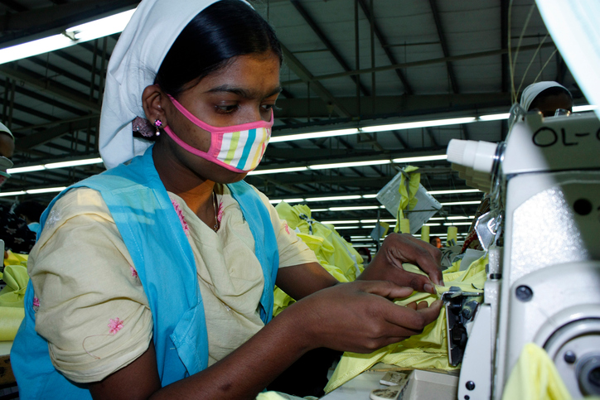
Large image
Factory Worker in Dhaka, Bangladesh
Source: abdul malek babul/Getty Images
Notes:
woman worker in garment industry
A woman worker in garment industry in the Gajipur District, Bangladesh. Garment manufacturing is the main income source of foreign currency of Bangladesh. Women make up a big part of this workforce.

Slide 9
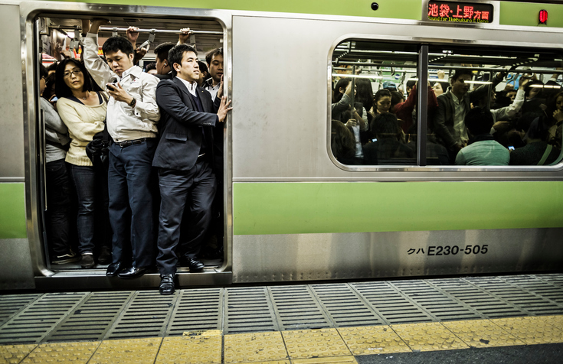
Large image
Crowded Subway in Tokyo, Japan
Source: aluxum/Getty Images
Notes:
Passengers inside an overcrowded Yamanote Line train at rush hour in Tokyo, Japan. Including the subway lines and all the other railways that operate in Tokyo, 40 million people travel with this kind of transportation everyday in the city.

Slide 10
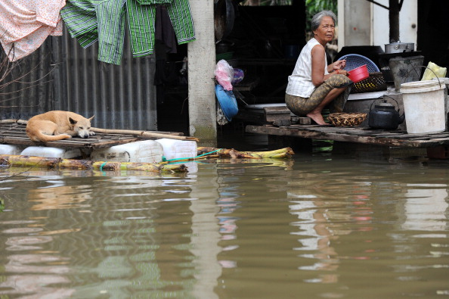
Large image
Urban Floods in Phnom Penh, Cambodia
Source: TANG CHHIN SOTHY/AFP/Getty Images
Notes:
A Cambodian woman crouches on a deck as floodwaters surround her house in Kandal province, 20kms east of Phnom Penh, Cambodia.

Slide 11
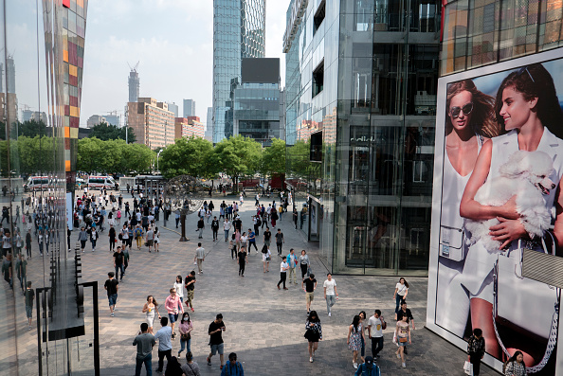
Large image
Trendy Shopping District in Beijing, China
Source: Zhang Peng/LightRocket/Getty Images
Notes:
People sightseeing and shopping in Sanlitun. Sanlitun is the fashion and business landmark in Beijing, China.
Source: Zhang Peng/LightRocket via Getty Images

Slide 12
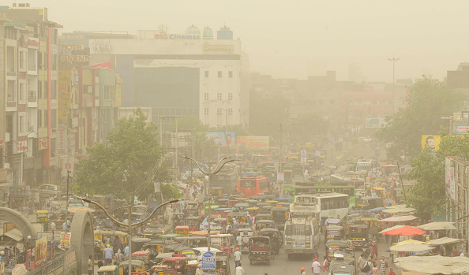
Large image
Air Pollution in New Delhi, India
Source: NARINDER NANU/AFP/Getty Images
Notes:
Air pollution soared in New Delhi on June 14 to hazardous levels rarely seen outside winter months.
Source: NARINDER NANU/AFP/Getty Images

Slide 13
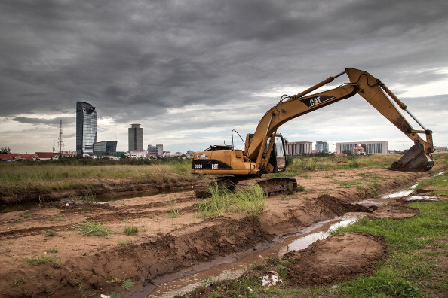
Large image
Loss of Farmland Near Phnom Penh, Cambodia
Source: Omar Havana/Getty Images
Notes:
An excavator is parked on the former Boeung Kak Lake in Phnom Penh, Cambodia. The plan was to to build hotels, luxury apartments and office buildings, but the only work finished when this picture was taken was to fill the lake with sand, (which previously had served as an important drainage site for the city) and to build a road through the middle, a project which evicted approximately 3,000 families in the process. Many of the families are still fighting for adequate compensation.

Slide 14
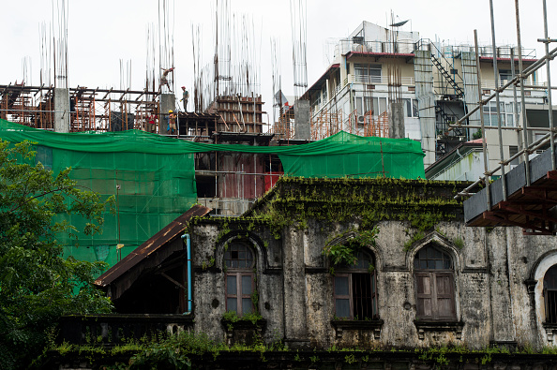
Large image
Neglected Heritage Building in Yangon, Myanmar
Source: ROMEO GACAD/AFP/Getty Images
Notes:
An abandoned colonial building marked for demolition in between construction sites of high rise apartments in Yangon, Myanmar. Many historical buildings from the British colonial era have already been razed by the flood of foreign investment that followed the end of total military rule in 2011 and has pushed the city into a development frenzy.
Source: ROMEO GACAD/AFP/Getty Images

Slide 15
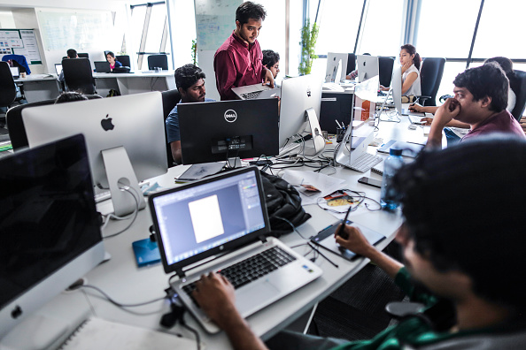
Large image
Young People Working in Mumbai, India
Photographer: Dhiraj Singh/Bloomberg via Getty Images
Notes:
Operations At Food Ordering Startup TinyOwl As India Fosters Surge Of Errand Apps
Tiny Owl employees work at computers inside the company's head office in Mumbai, India, on Monday, March. 9, 2015. Tiny Owl is a smartphone application that helps hungry city-dwellers scour nearby eateries for deliveries. The service now handles 2,000 orders each day and has caught the interest of venture funds including Sequoia Capital, an early backer of technology giants such as Apple Inc. and Oracle Corp.

Slide 16
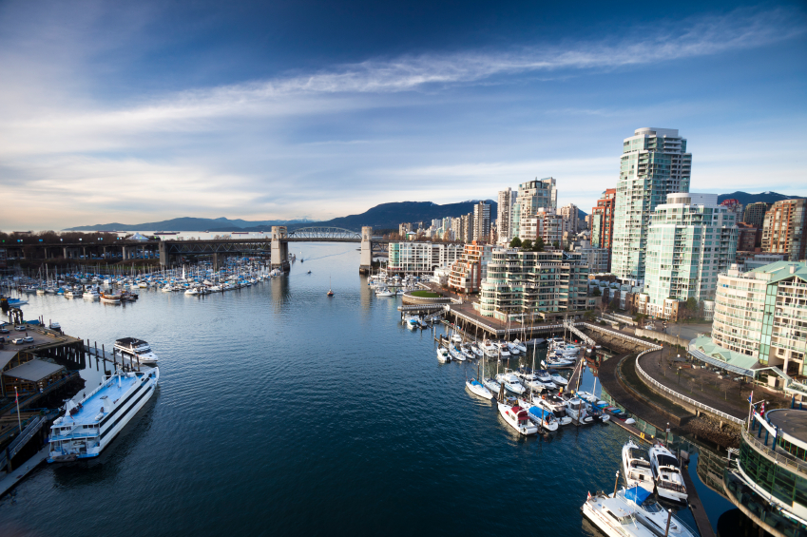

Urbanization in Asia
https://asiapacificcurriculum.ca/

