Slide 1


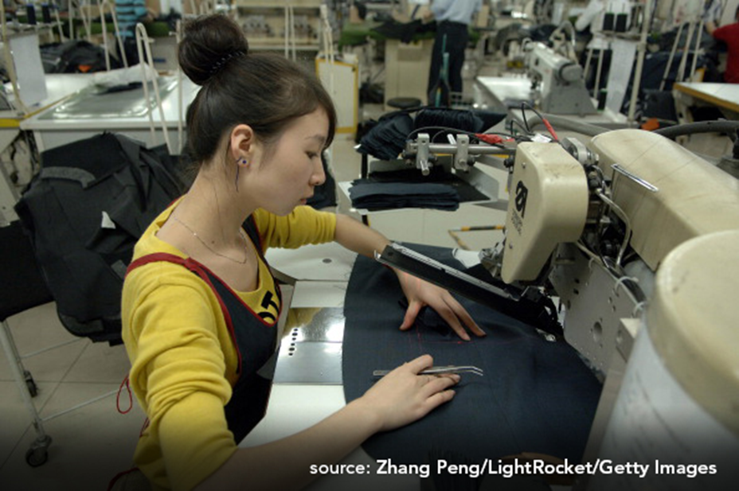
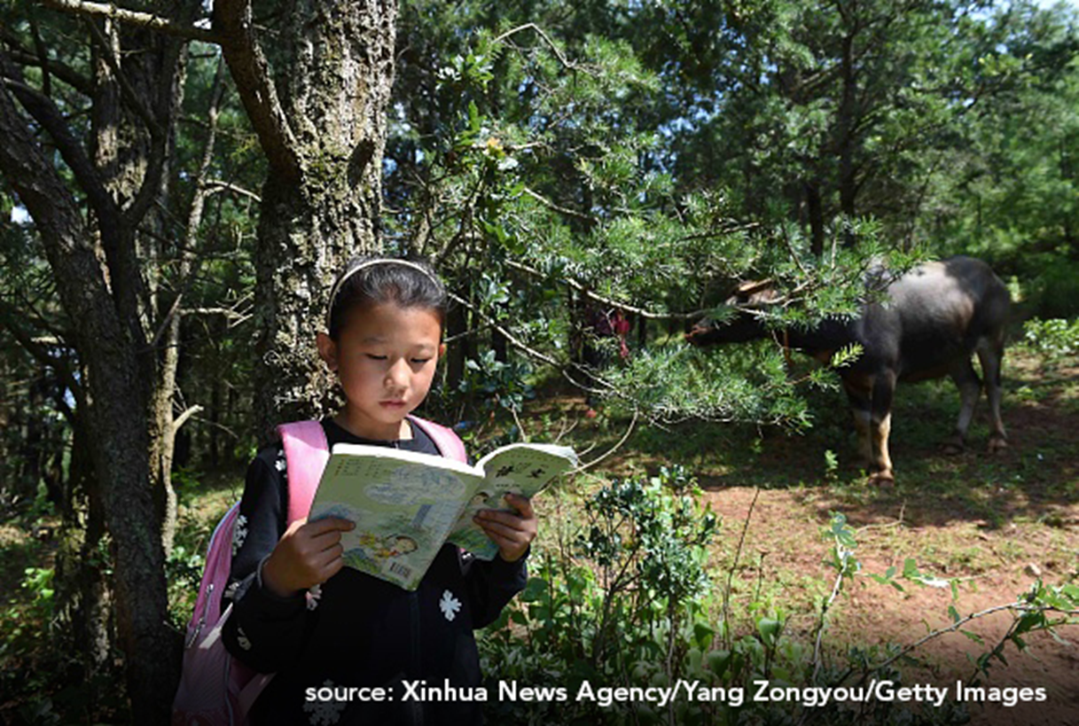

China
Urbanization Case Study

Slide 2

Large image
The Member of the Ant Tribe
Source: Zhang Peng/LightRocket/Getty Images

Slide 3
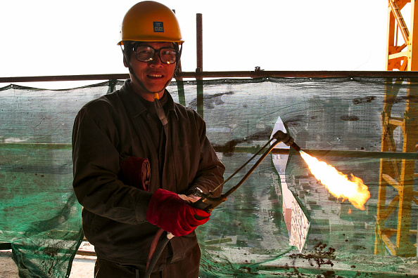
Large image
The Migrant Worker
Source: Ben McMillan/Construction Photography/Avalon/Getty Images

Slide 4
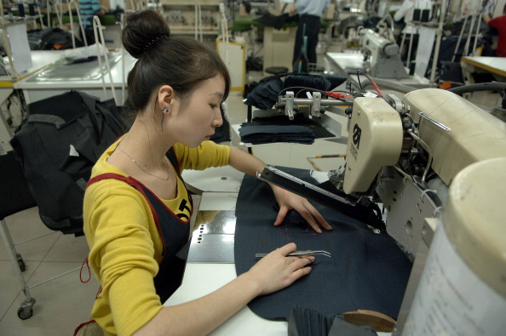
Large image
The Factory Girl
Source: Zhang Peng/LightRocket/Getty Images

Slide 5
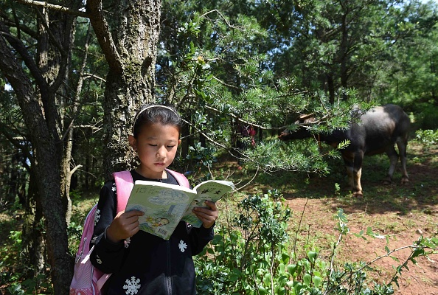
Large image
The ‘Left Behind’ Girl
Source: Xinhua News Agency/Yang Zongyou/Getty Images

Slide 6

Large image
The Old Beijinger
Source: Marka/UIG/Getty Images

Slide 7
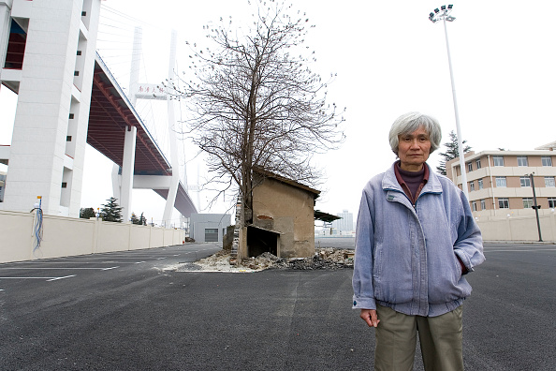
Large image
The Nail House Owner
Source: Lucas Schifres/Getty Images

