Slide 1
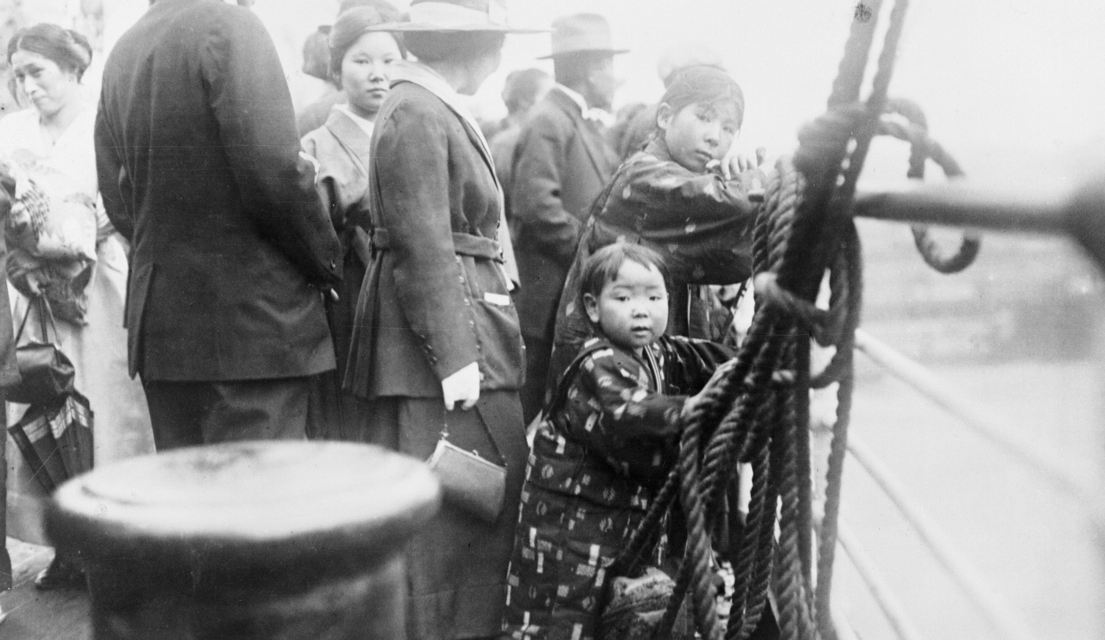


Asian Migration in the 19th and Early 20th Centuries
Image Set

Slide 2
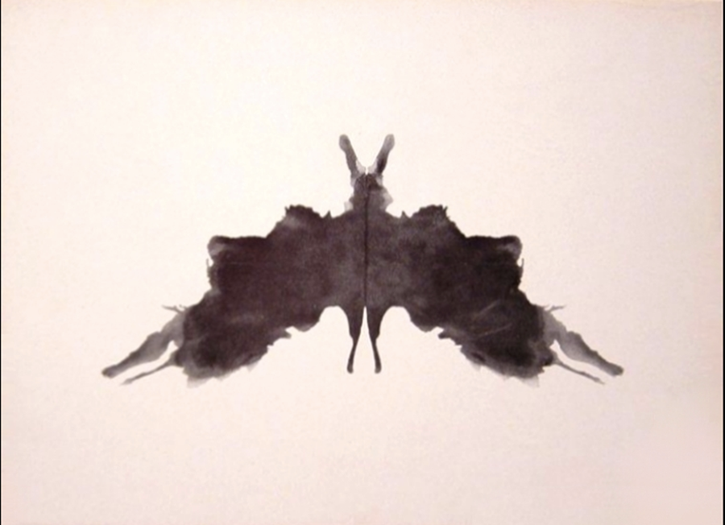
Notes:
Image 1 https://en.wikipedia.org/wiki/Rorschach_test#/media/File:Rorschach_blot_05.jpg

Slide 3
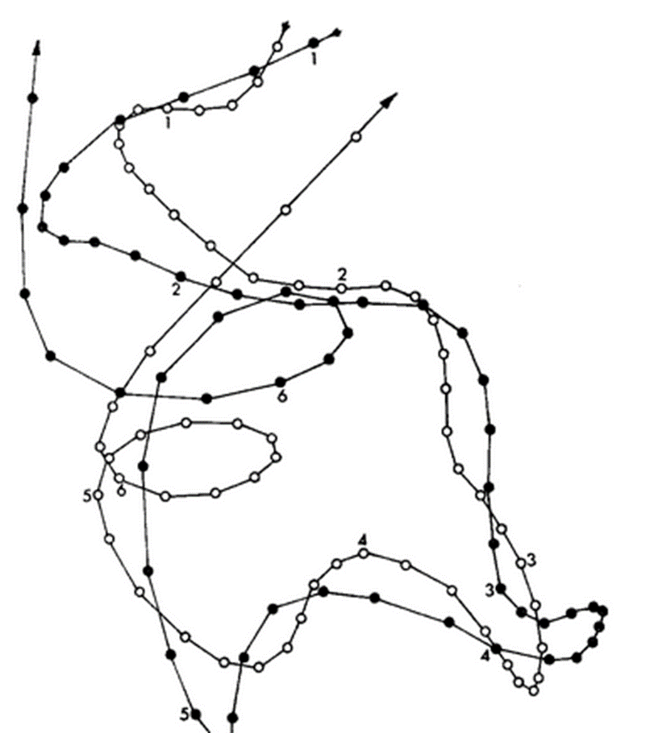
Notes:
Image 2 http://www.pc.rhul.ac.uk/staff/J.Zanker/old_web_stuff/teach_previous/PS3060/L2/Ps3060_2.htm

Slide 4
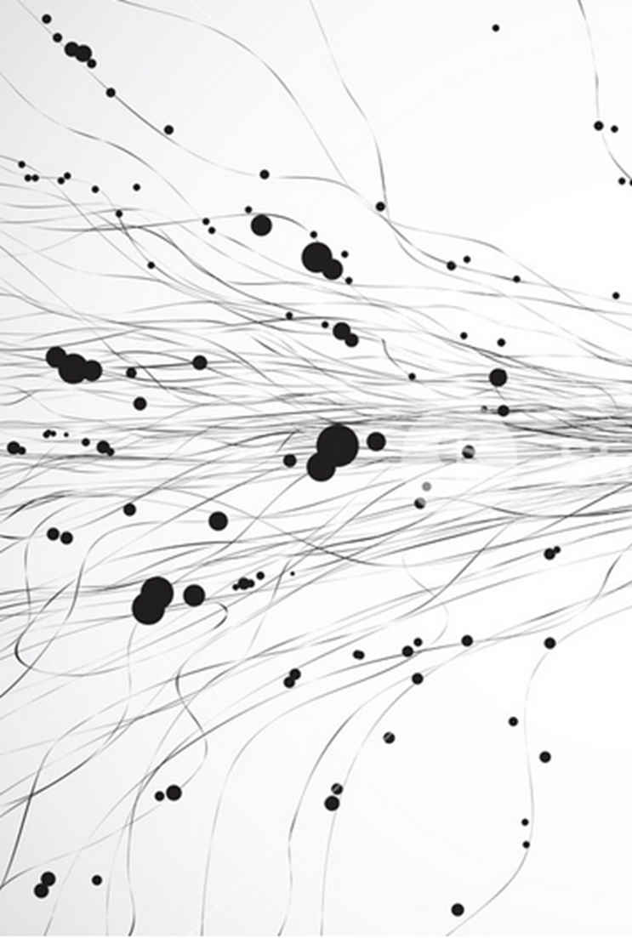
Notes:
Image 3
https://www.storyblocks.com/stock-image/vector-abstract-line-art-texture-sch33v8xozj6gqcugx

Slide 5

Notes:
Image 4
https://pixabay.com/en/audio-aural-ear-hearing-music-2028515/

Slide 6

Notes:
Image 5
http://www.alamy.com/stock-photo-abstract-element-with-contour-lines-of-intersecting-random-circles-94311514.html

Slide 7
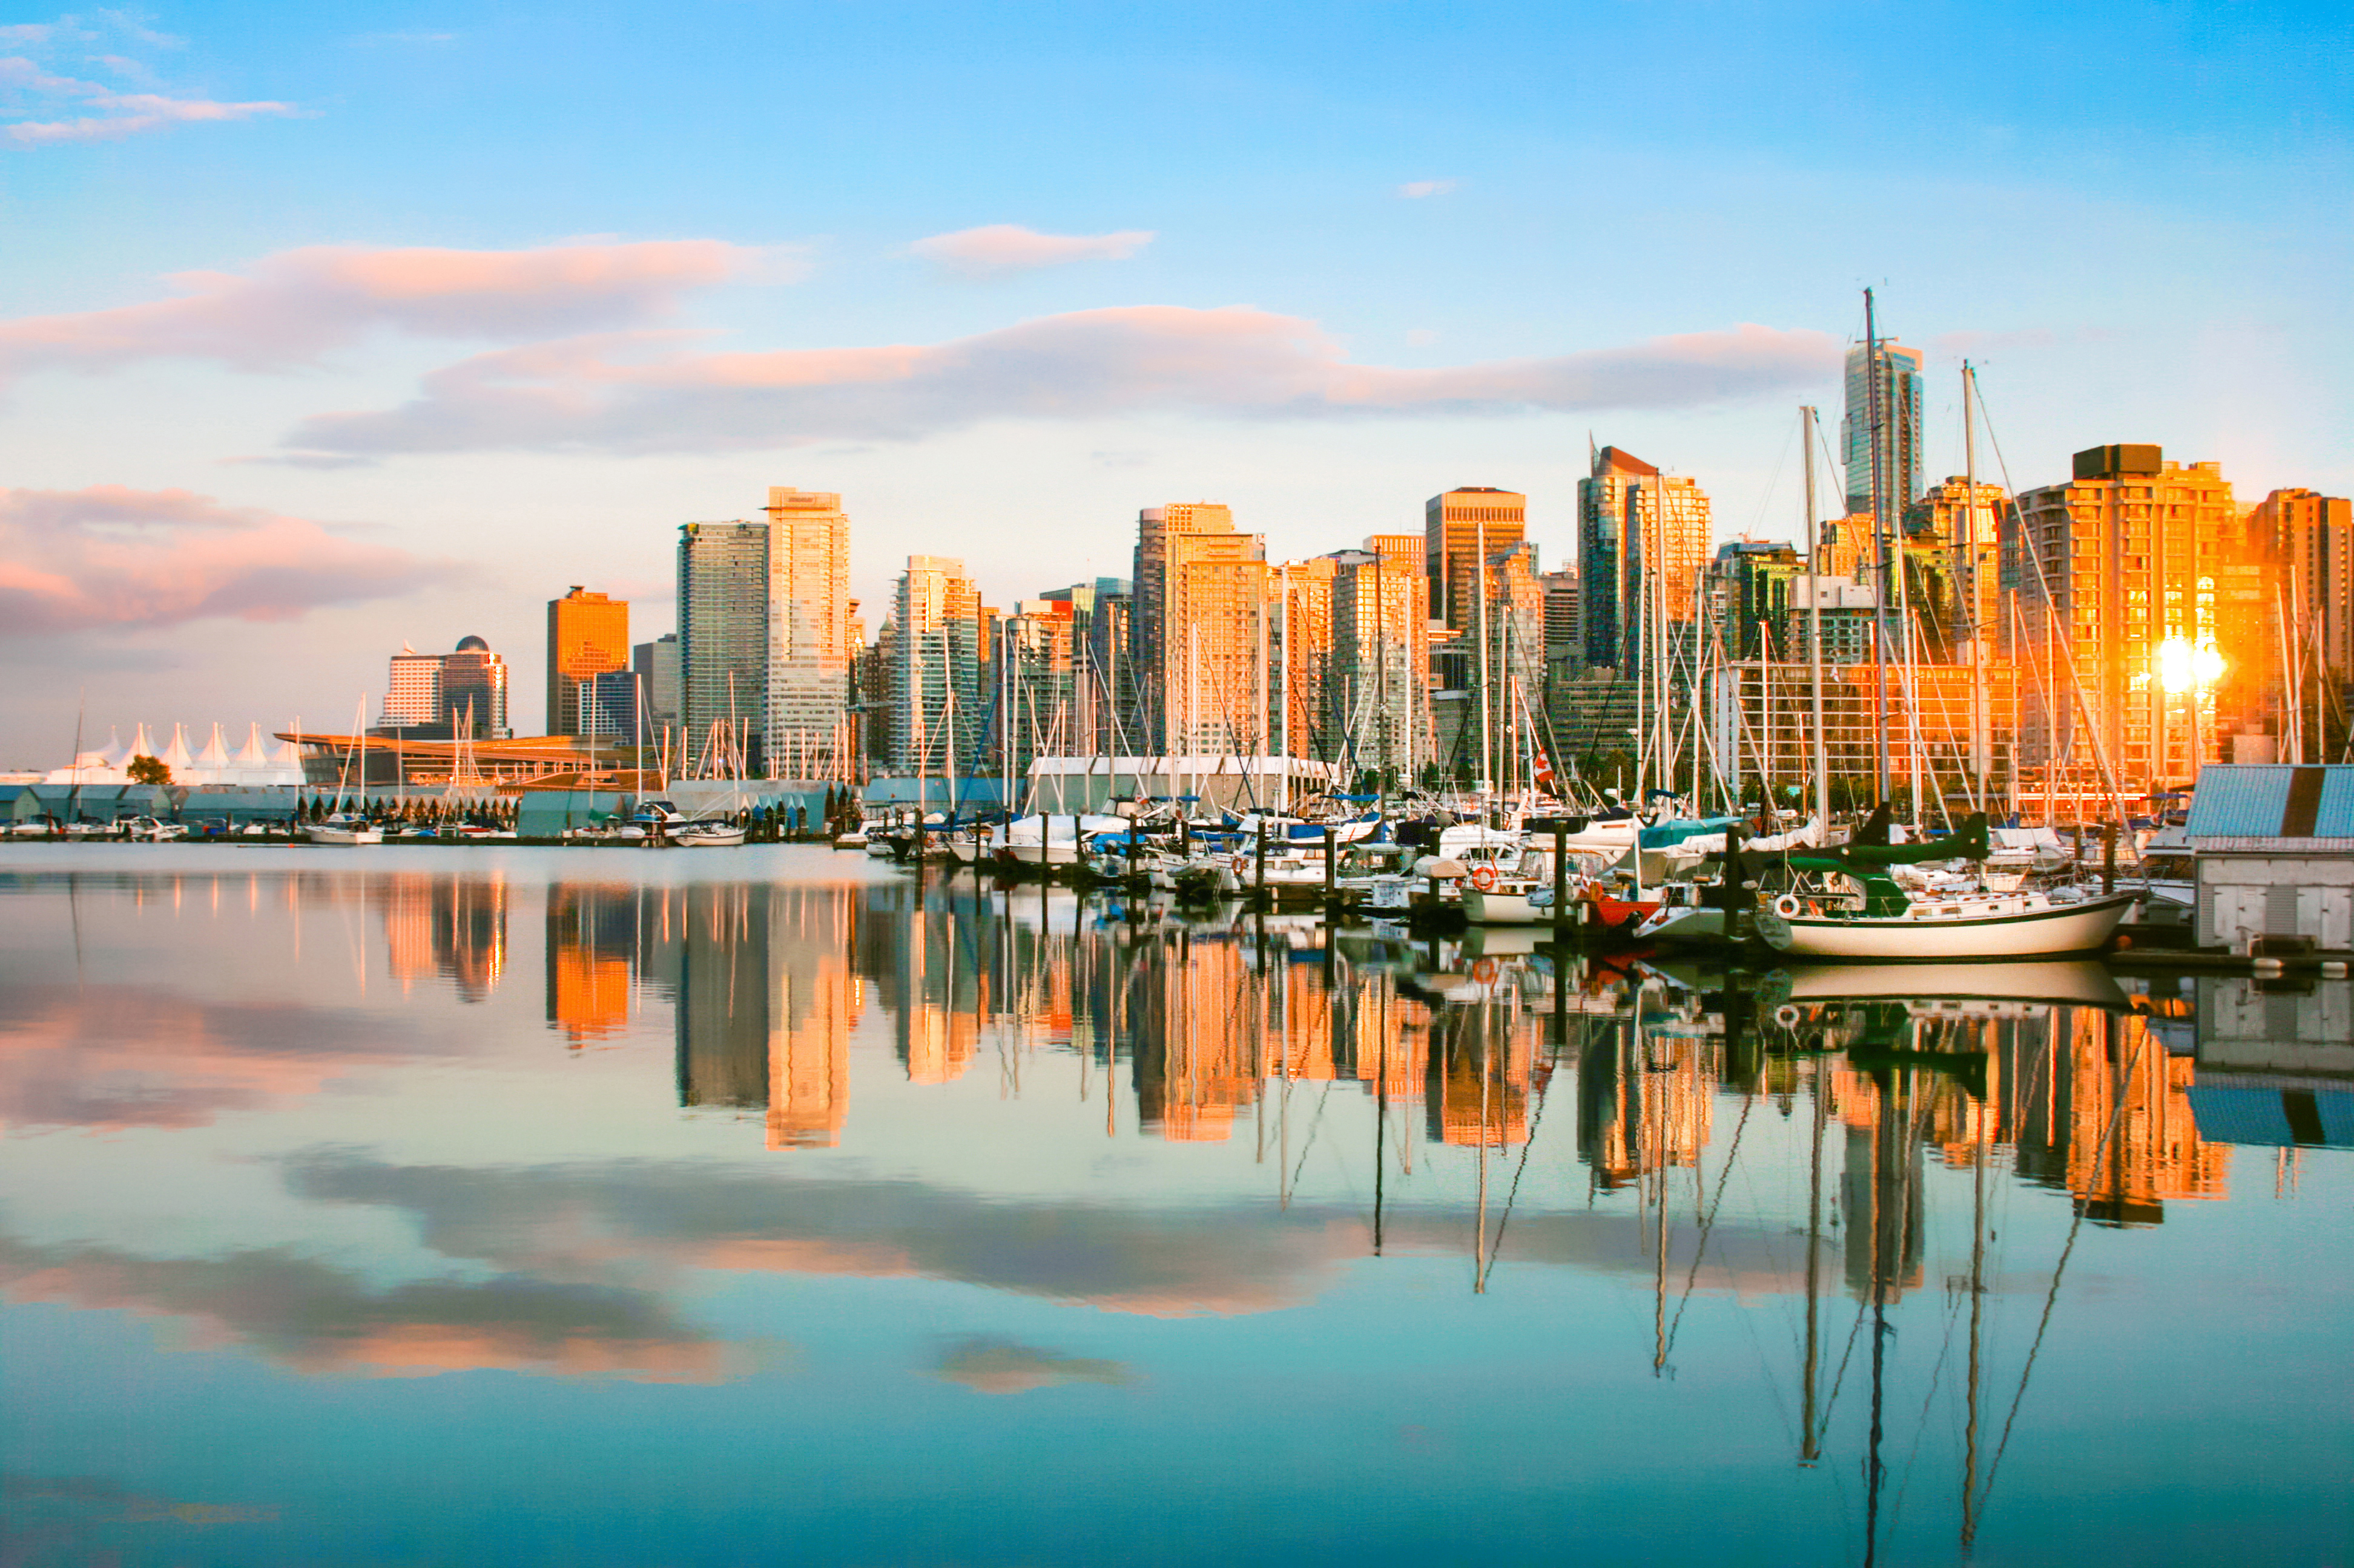
The Asia Pacific Curriculum project is being undertaken in partnership with the British Columbia (B.C.) Ministry of Education
More curriculum resources available at: https://asiapacificcurriculum.ca/

