Slide 1
Asia Profiles: Mongolia
Charts and Graphs

Slide 2
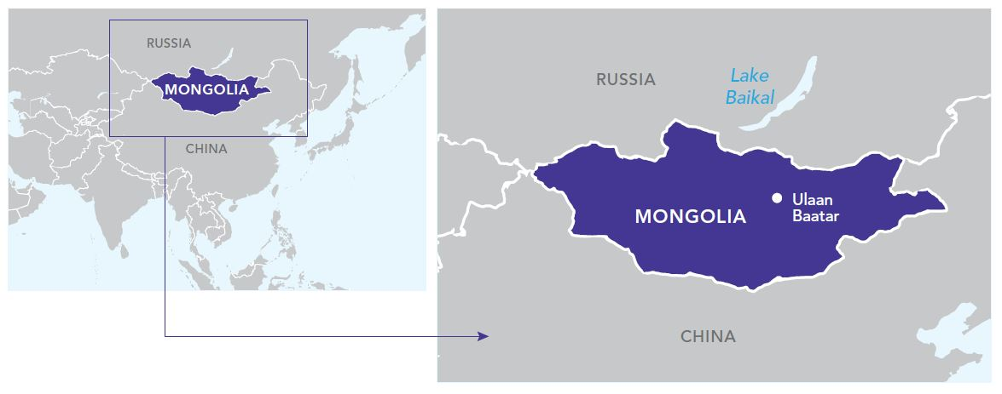
Map of Mongolia

Slide 3
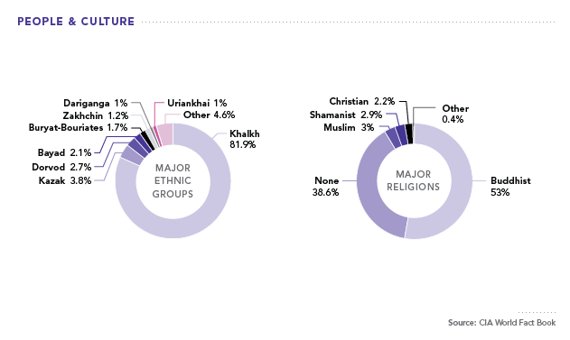
People & Culture

Slide 4
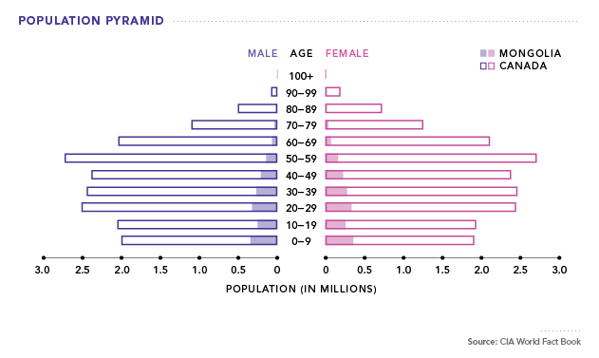
Population Pyramid

Slide 5
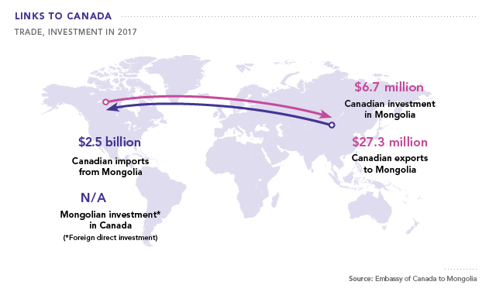
Links to Canada (Trade, Investment in 2017)

Slide 6
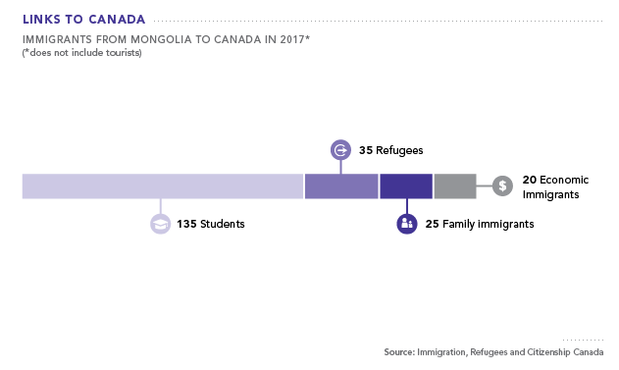
Links to Canada (Immigrants from Mongolia to Canada in 2017)

Slide 7
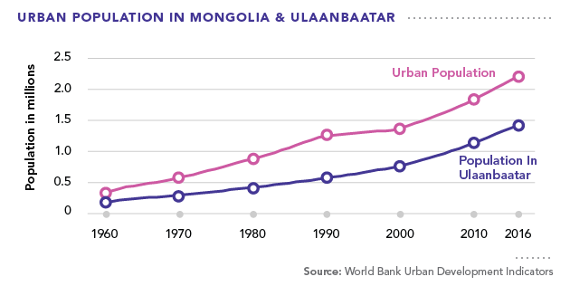
Urban Population in Mongolia & Ulaanbaatar

Slide 8
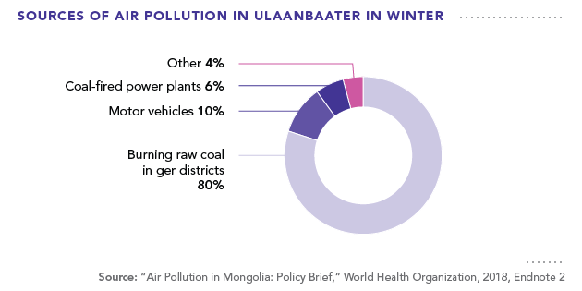
Sources of Air Pollution in Ulaanbaatar in Winter

Slide 9
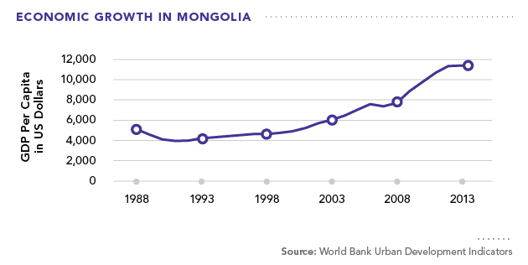
Economic Growth in Mongolia

Slide 10
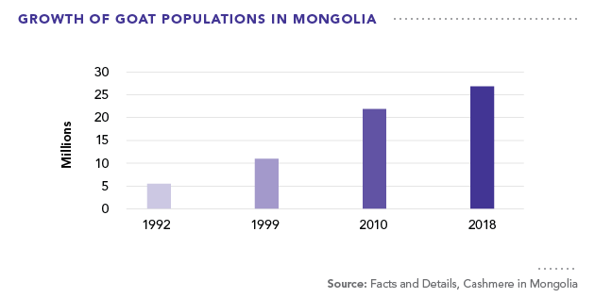
Growth of Goat Populations in Mongolia

Slide 11
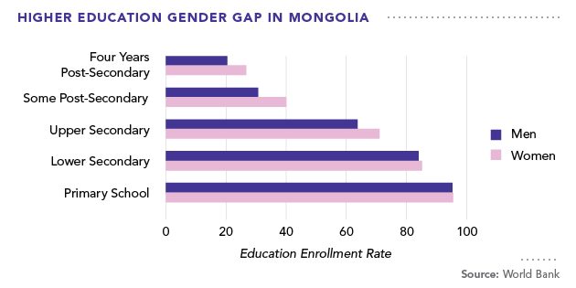
Higher Education Gender Gap in Mongolia

Slide 12
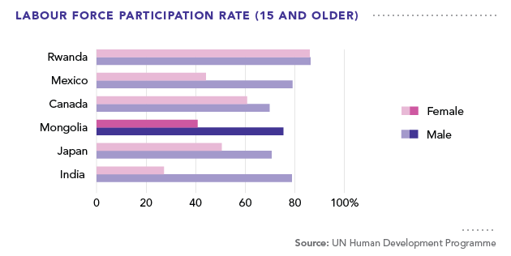
Labour Force Participation Rate (15 and Older)

Slide 13
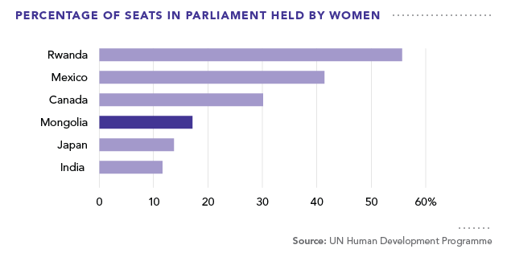
Percentage of Seats in Parliament Held by Women

