Slide 1
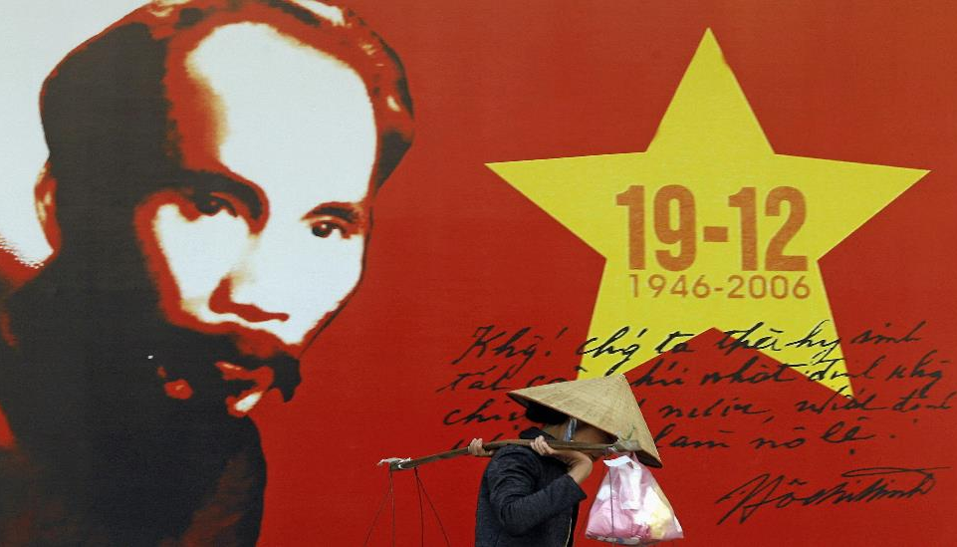



Vietnam after the War:
1975 – Present

Slide 2
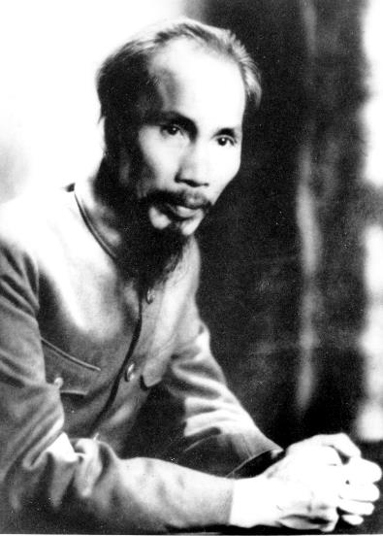
Brief Timeline of the American/Vietnam War
  1858-1954: French colonization
  1930: Ho Chi Minh establishes Indochinese Communist Party (ICP)

Slide 3
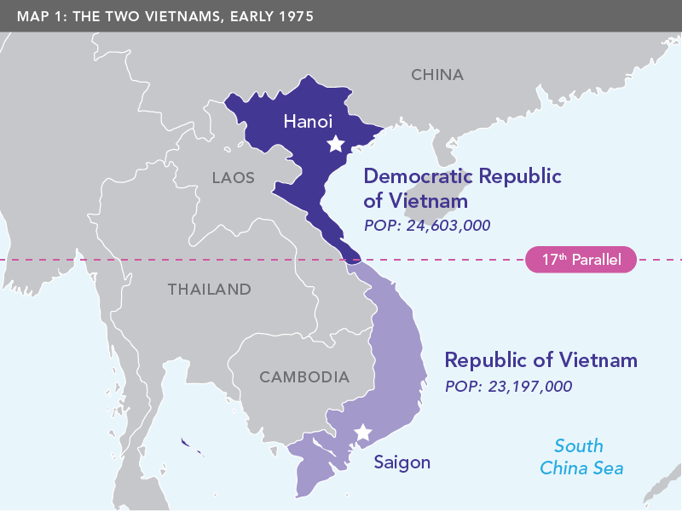
Timeline Continued
  1954: Viet Minh/Indo-chinese Communist Party (ICP) defeats French
  Geneva Conference divides Vietnam into North, South

Slide 4
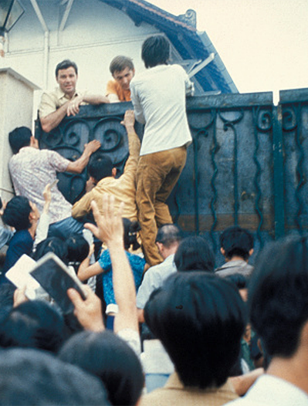
Timeline Continued
  1964-67: U.S. increases combat troops
  1968-69: Joint North Vietnam-Viet Cong assault on South
  1973: Paris Peace Accords – North, South, U.S. agree to ceasefire
  1975: Fall of Saigon – South surrenders to North
  Up to two million civilians + 1.3 million Vietnamese soldiers dead

Slide 5

After the War

Slide 6
Questions
  What will happen to southerners who worked with South Vietnamese or American governments?
  What role will non-communist allies of the North play in a reunified Vietnam?
  What will the post-War economy look like?

Slide 7
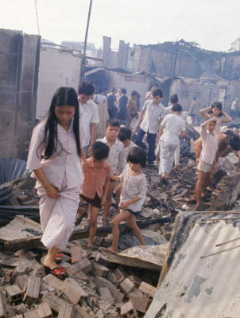
Challenge 1: Rebuilding
Rebuilding the south’s infrastructure, economy:
  Landscape (and people) devastated by bombing and use of chemical defoliants (e.g., Agent Orange)
  Saigon radio says people have to work more hours, including to help build roads to link north and south.

Slide 8
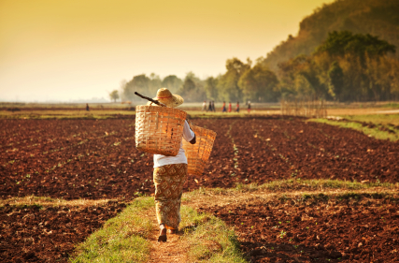
Challenge 2: Reconciliation
  Civil wars result from, and sometimes deepen, divisions within societies.
  Professor Christopher Goscha (University of Québec at Montréal): “Those divisions do not simply disappear once the fighting stops.”
  Reconciliation, as defined by Desmond Tutu, Nobel Peace Prize winner from South Africa: “healing the wounds and divisions of a society in the aftermath of sustained violence.”
  How does a government of a post-civil war society balance the need to establish control and the need to reconcile with former enemies?

Slide 9
Consolidating Political Control

Slide 10
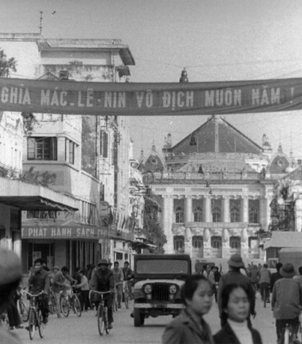
Defining and Dealing with Political Enemies
  1973 Paris Peace Accords: South Vietnam was supposed to continue as separate, sovereign state until North and South agree on how to unite through elections or negotiations.
  National Liberation Front (NLF) fought alongside North to defeat the South and U.S.; included both communists and non-communists
  Some NLF leaders hoped to maintain a neutral, non-communist southern state.
But…
  1976 meeting of northern, southern delegates: Decision to merge North and South into single state under control of North-led communist government.

Slide 11
Re-education Camps
  For ideological indoctrination
  For ‘good’ people, was relatively mild (e.g., like attending a class)
  For ‘enemies,’ both real and suspected, more like a prison camp

Slide 12
Re-education Camps
  Our generation in the South was suddenly charged with wrongdoing because we had not lived in the North, had not been used to the way of reasoning of the Northern people, had not accepted their ideology. Our skin was the same color, we spoke the same language, our ethnic origin and geographic location were the same, and yet we were completely different from them. When Northern soldiers poured into the South, they had appeared to our eyes as country folks who had strayed into a big town…Living in their company, observing their way of life and thinking, and especially experiencing our treatment in the camp, we had come to realize that between us and them was a barrier that could never be overcome.
“
”
Tran Tri Vu,
Lost Years: My 1,632 Days in Vietnamese Re-education Camps

Slide 13
Introducing Socialist Economic System

Slide 14
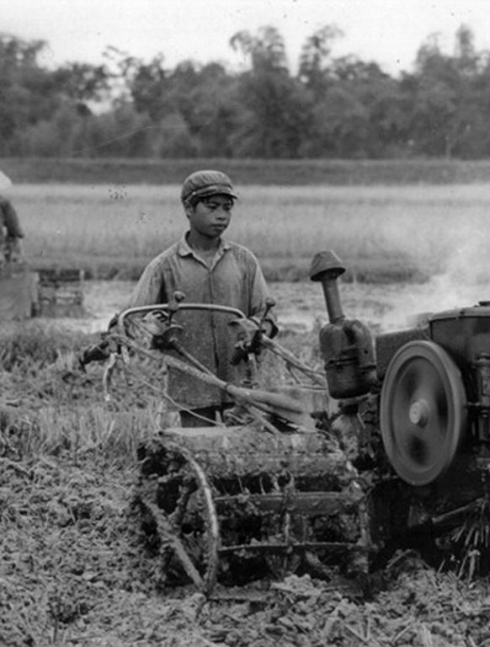
Economic Changes
Nationalization (confiscation) of private property
New Economic Zones (NEZs), agricultural collectives
“People were transported to the NEZs and told to produce crops with no equipment guidance. The people received no food and were reduced to eating the leaves off the trees and bushes. There were well known cases of people [in] the NEZs...”
Interview with former religious figure in Vietnam, July 20, 1979, cited in Ben Kiernan, Viet Nam: A History from the Earliest Times to the Present

Slide 15
Failures of Socialism in the South
  Food shortages by late 1970s
  Appear “to have been caused by a combination of factors—a prolonged drought this year, government mismanagement and resistance to collectivization.”
  Prime Minister Pham Van Dong says “now we are facing many difficulties in feeding ourselves.”
  Vietnam’s press agency acknowledges “We have made big mistakes in leadership, especially in guiding and organizing the implementation of the party’s line and policies on agriculture.”
Source: Fox Butterfield, “Serious Shortages Forcing Vietnam to Cut Rice Rations,” New York Times, October 2, 1977

Slide 16
The People React

Slide 17
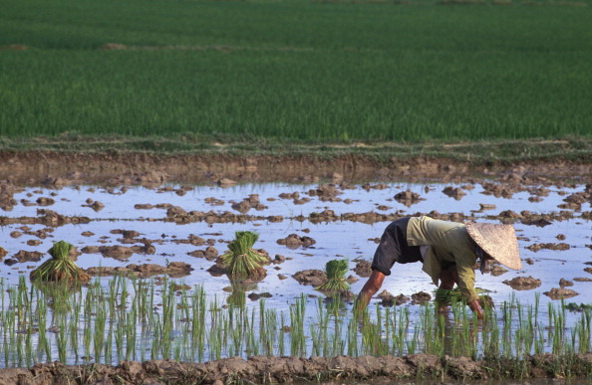
Southern (and Norther) Resistance
  People quietly withdrawing from agricultural collectives or saving their energy for their private gardens.
  Example of “weapons of the weak” (James Scott): small but persistent actions or inactions by those who lack formal power to push back against those who have formal power.

Slide 18
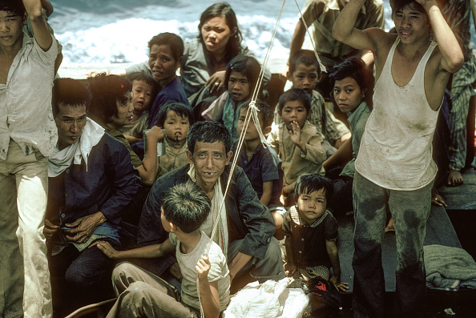
The “Boat People” Crisis
  By late 1970s, tens of thousands of people leaving despite dangers
  About 10% died from drowning, disease, pirates, poor conditions on boats
  United Nations High Commissioner for Refugees called it “an appalling human tragedy”

Slide 19
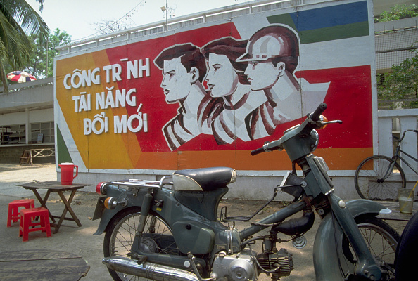
Government Reacts
  Sixth Party Congress (meeting of Communist Party) officials in 1986
  Context:
    Inflation about 700%, strains on budget (e.g., military expenditures, state economy), almost no foreign investment, technology gap
  April 1986 death of Le Duan, hardline leader of Communist Party/government
  Introduction of doi moi (“renovation”) economic reforms

Slide 20
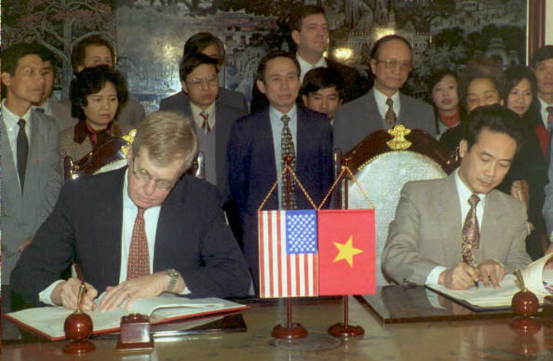
Normalization of Relations with United States in 1995
  Two U.S. Vietnam Veterans – Senator John Kerry and Senator John McCain – were part of the reconciliation process.
  Trade growth from US$451 million in 1994 to US$54.6 billion in 2017.

Slide 21
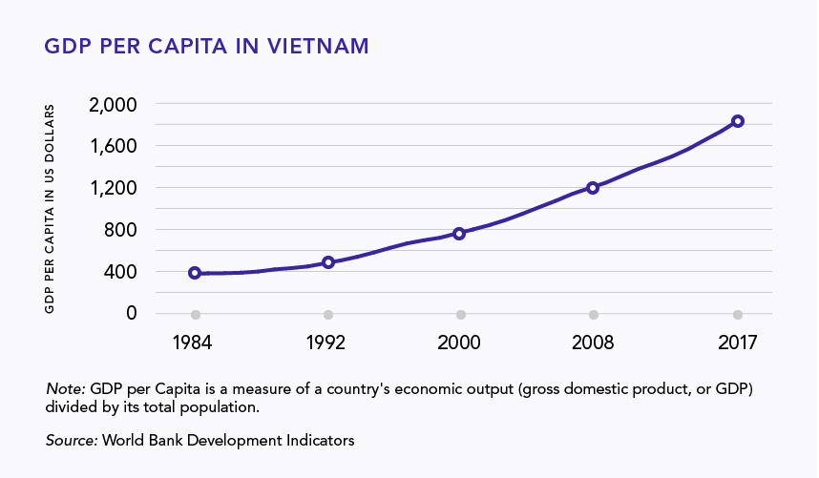
Vietnam’s Economic Future

Slide 22
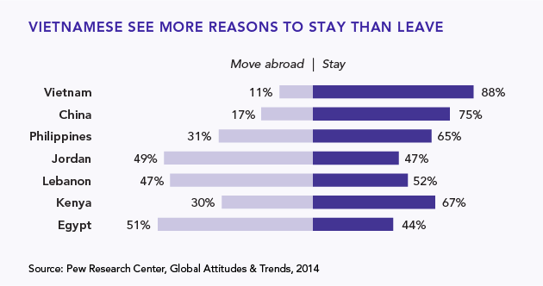

Future Optimism(1)
In a Pew Global survey, people in 44 countries were asked whether they thought their children, when they grow up, will be better off or worse off financially than their parents. People in Vietnam were the highest in saying “better off.”

Slide 23
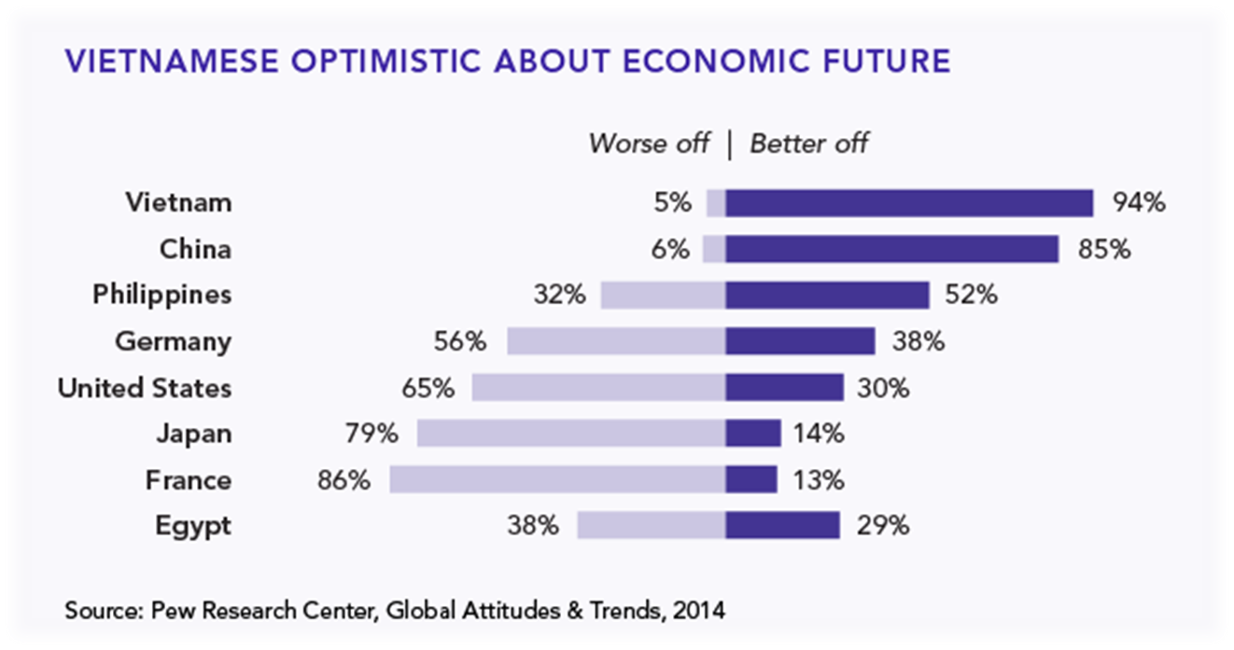
Future Optimism(2)
In the same survey, people were asked: What would you recommend to a young person who wants a better life – moving abroad or staying in the country? An overwhelming percentage of Vietnamese recommended staying.

Slide 24
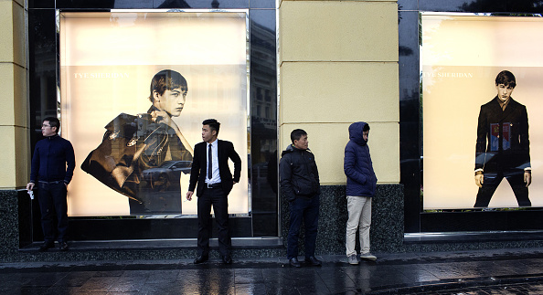
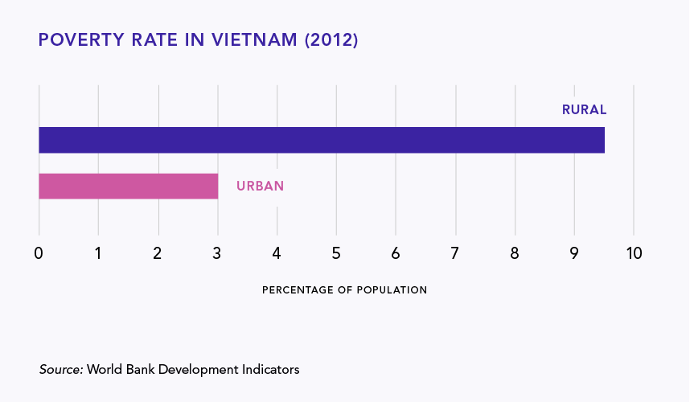
A Tale of Two Vietnams
  Today, Vietnam is richer, but also more unequal

Slide 25


Thank you!
Please visit our website for more Asia-Focused Resources for Teachers and Students: https://asiapacificcurriculum.ca/

