Slide 1
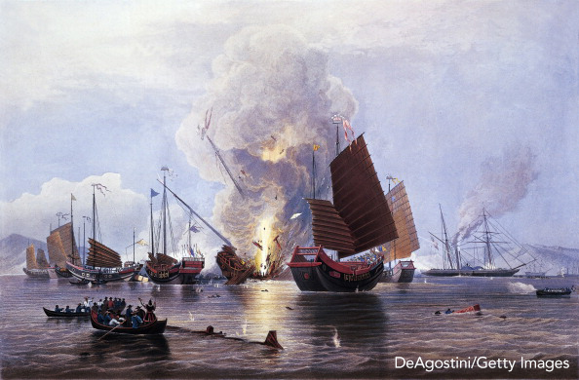
THE OPIUM WARS
Ms. Paget, West Vancouver Secondary
Notes:
https://www.deamuseum.org/ccp/opium/production-distribution.html

Slide 2
‘FREE’ TRADE AND CHINA
In the years leading up to the Opium Wars, foreign trade was strictly controlled by the Chinese using the “Canton System.”
The British ran a three-country trade system: British goods to India, Indian cotton and British silver to China, and Chinese tea and other goods to Britain.
The British felt this system was ‘unbalanced’ and sought to shift the balance in their favour by selling a new product to China instead of cotton: opium

Slide 3
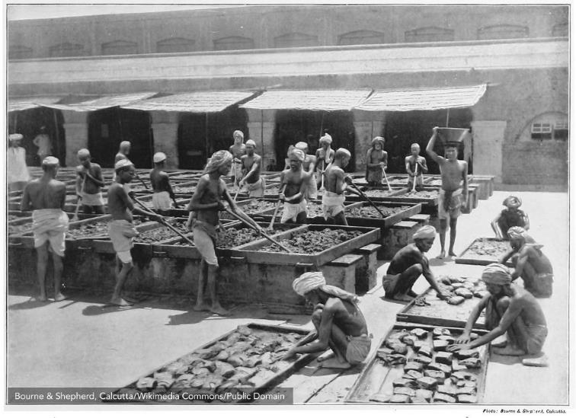
OPIUM PRODUCTION IN INDIA
Linda Grove/Getty Images

Slide 4
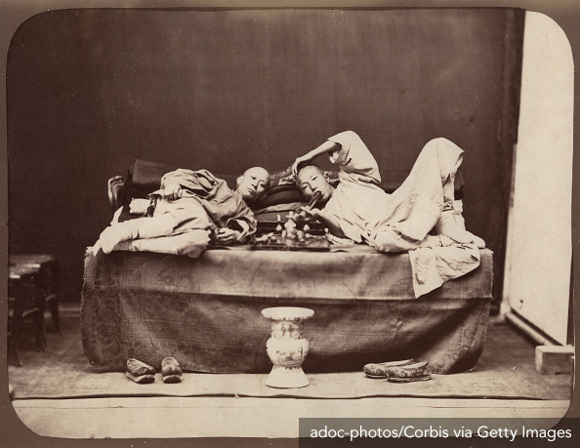
OPIUM SMOKERS

Slide 5
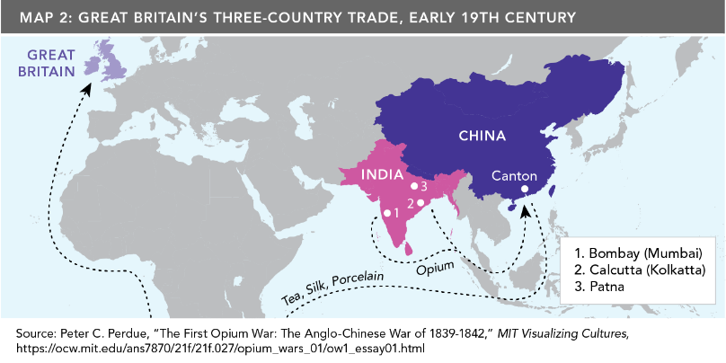
OPIUM ROUTES

Slide 6
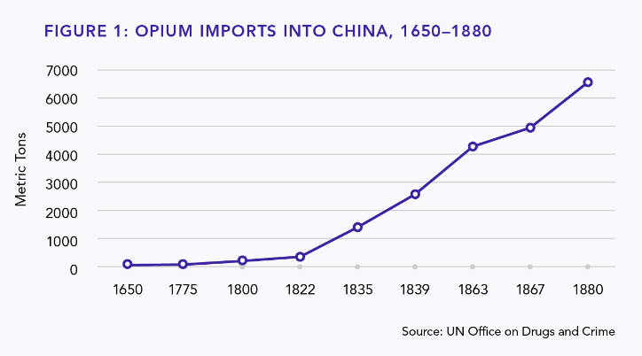
OPIUM WARS
The scourge of opium
For centuries, opium had been used in China and Eurasia for medicinal and some recreational purposes, but with the purposeful flow inwards to China, addiction became a problem.

Slide 7
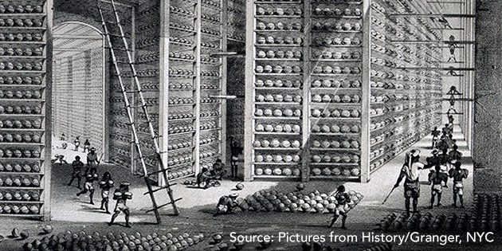
PRODUCTION & STORAGE OF OPIUM
IN INDIA FOR TRADE WITH CHINA
Notes:
https://history.libraries.wsu.edu/fall2015/2015/09/01/derek-coburn/

Slide 8
OPIUM WARS
By 1790 the Chinese government realized that the opium trade and addition was a problem.
In 1800, it banned both the production and importation of opium.
In 1813, the Chinese government outlawed the smoking of opium and imposed a punishment of beating offenders 100 times.

Slide 9
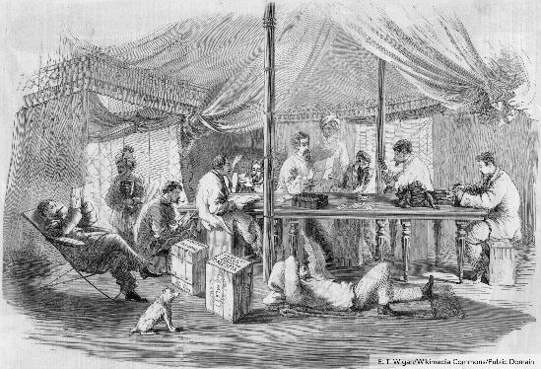
OPIUM WARS
The British East India Company fights back
The British East India Company licensed private British and American traders to bring the opium in via Chinese smugglers

Slide 10
OPIUM WARS
1810-1838: The height of the trade
Increase from 4,500 chests of opium per year to 40,000 chests of Opium per year.
Britain’s profit increased from two million ounces of silver flowing out of China in exchange for opium in the early 1820s to about nine million ounces in the early 1830s.

Slide 11
OPIUM WARS
Addiction: Not just how many, but who
“[In] 1838, Lin Tse-hsu was insisting that at least 1 per cent of China’s population used [opium]. But these figures…were not as important as the appearance of ubiquitous opium smoking. In urban centres or along the routes of trade and in densely-populated river deltas, its existence could not be ignored. Since addiction was costly, it went with leisure time and extra income. Therefore, it was usually found among wealthy members of the gentry, officials of the central government (some said one-fifth were addicts), yamen clerks (Lin Tse-hsu estimated a four-fifths addiction rate) and soldiers….the court was terrified at the thought that the entire government was rotten with addiction.”
John King Fairbank (ed.) The Cambridge History of Modern China, Vol. 10,
Cambridge: Cambridge University Press, 1978, p. 174.
Notes:
Lin Tse-hsu is a version of the spelling of Lin Zexu.

Slide 12
OPIUM WARS: CHINA’S OPTIONS
‘Users’ argument
‘Pushers’ argument
Chinese government could legalize and tax the use of opium.
This would stem the flow of silver out of China, discourage non-addicts from trying the drug (due to price).
Without swift action there would be no one working enough to pay taxes.
Focus on morality: opium as “evil.”
Focus on the pushers.

Slide 13
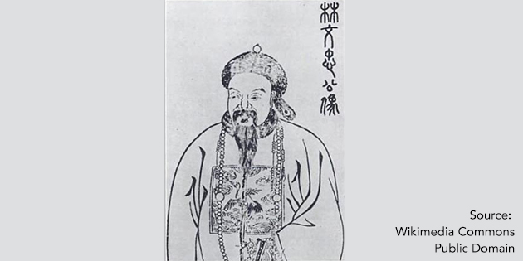
OPIUM WARS
Lin Zexu’s argument wins the day
Strictly and efficiently enforced 1836 ban by arresting over 1,600 Chinese dealers and destroying tens of thousands of pounds of opium.
Demanded that foreign firms hand over their opium stores in exchange for tea, halted trade, and seized the merchants’ supplies if they refused to comply.

Slide 14
OPIUM WARS
“By what right do they then in return use the poisonous drug to injure the Chinese people? Even though the barbarians may not necessarily intend to do us harm, yet in coveting profit to an extreme, they have no regard for injuring others. Let us ask, where is your conscience? I have heard that the smoking of opium is very strictly forbidden by your country; that is because the harm caused by opium is clearly understood. Since it is not permitted to do harm to your own country, then even less should you let it be passed on to the harm of other countries -- how much less to China!”
Excerpt taken from Lin Zexu’s letter to Queen Victoria in 1839.

Slide 15
OPIUM WARS
Lin Zexu’s accomplishments
Foreign merchants handed over more than 20,000 chests
(2.6 million pounds) of opium in 6 weeks.
Seized and destroyed the opium on British ships around China.
Pressured the Portuguese to move the British out of Macau into Hong Kong.
These accomplishments in Lin Zexu’s fight against opium came with costs. These events would lay the groundwork for the British declaration of war in November 1839.

Slide 16
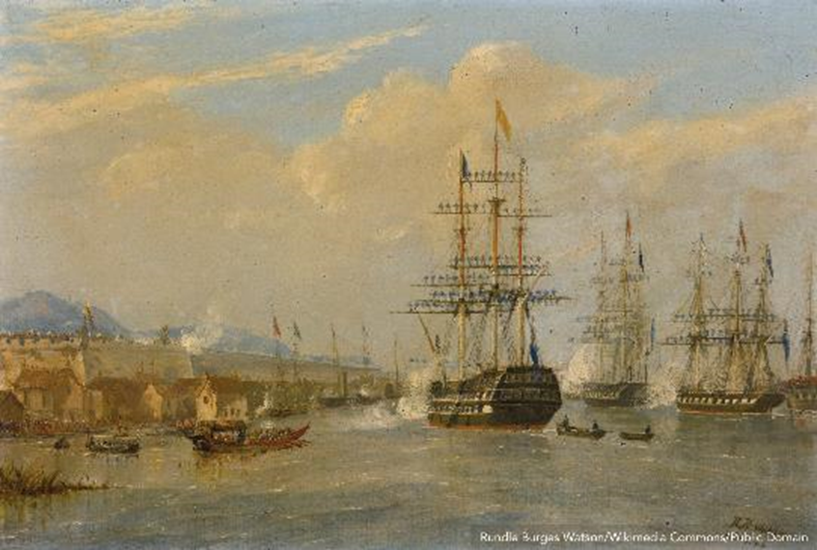
FIRST OPIUM WAR

Slide 17
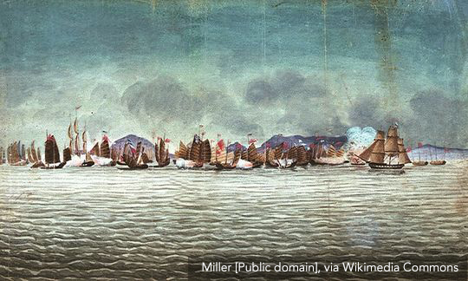
TECHNOLOGICAL MISMATCH
The story of the Hyacynth & Volage vs 29 Junkers
Notes:
On November 3, 1839—still with no declaration of war having emanated from either side—the unresolved Kowloon incident coupled with other complications precipitated a dramatic military confrontation at Chuanbi on Canton Bay. On this occasion, two British frigates—the 28-gun Volage and 18-gun Hyacinth—took on 29 Chinese vessels that were blockading the harbor (16 war junks and 13 “fire-boats,” craft packed with straw and brushwood, sometimes covering chests of gunpowder, that were set ablaze and floated toward the wooden ships of the enemy). One junk was blown to bits by a lucky shot to its magazine, several other junks were sunk or heavily damaged, and only one British sailor was wounded as opposed to at least 15 Chinese killed.
Source: https://ocw.mit.edu/ans7870/21f/21f.027/opium_wars_01/ow1_essay03.html
Photo source: HMS Volage & HMS Hyacinth confront Chinese
war junks at Chuenpee, November 3, 1839, by Miller
National Maritime Museum
[1839_ChWar_PAF4873_nmm]

Slide 18
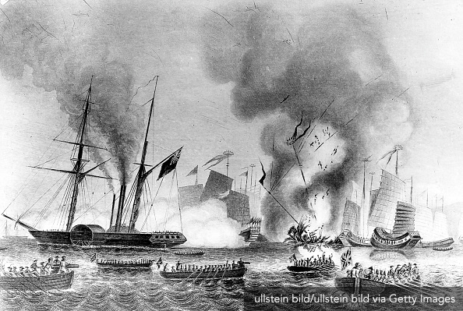
TECHNOLOGICAL MISMATCH
The Nemesis
Notes:
“[The first Opium War] was not only the most decisive reversal the Manchus had ever received, it also saw innovations in Western military technology and tactics. The emergence of the steam-driven vessel as a considerable force in naval battles was perhaps the most important of these, as shown by the campaign record of the British ship Nemesis. The Nemesis was an uncoppered paddle-wheel iron ship that used sails in favorable winds and six boilers fired by wood or coal for making seven to eight knots even in heavy seas. Drawing only five feet, the ship could operate in shallow coastal waters in virtually any wind or tidal condition. In the Canton Bogue campaigns, the Nemesis roamed the shallows firing grapeshot, heavy shells, and explosive rockets, grappling and towing junks, ferrying troops, and towing the sailing vessels on calm days. In the Shanghai campaign, the ship towed the men-of-war with their heavy guns into firing range on the city and served as a transport that could unload the British directly onto the docks.
-Source: Jonathan D. Spence, The Search for Modern China, New York: W. W. Norton & Company, 1990.

Slide 19
CHINA’S RESPONSE TO
BRITAIN’S SHIPS
“…as the British proceeded with their campaigns in 1842, they found much evidence of the speed with which the Qing officials were trying to respond to the West’s new technology. In Xiamen, for instance, they found a nearly completed replica of a British two-decker man-of-war with thirty guns; it was almost ready to sail, and work on several other similar vessels was well under way. In Wusong, they discovered five new Chinese paddle-wheel boats armed with newly cast brass guns, perfect in detail down to the sights cast on the barrels and the pierced vents for flintlocks. All were mounted on sturdy wooden trucks with iron axels. At least some people in China had clearly found the barbarian challenge to be a stimulus as well as an outrage.”
Source: Jonathan D. Spence, The Search for Modern China,
New York: W. W. Norton & Company, 1990.

Slide 20
OPIUM WARS
The Treaty of Nanjing
Deep water port at Hong Kong
Huge indemnity of 20 million silver dollars: 12 million for Britain’s war costs, 3 million to compensate English merchants for their debts, and 5 million as compensation for opium that Lin Zesu destroyed
Five new Chinese treaty ports (Guangzhou, Shanghai, Xiamen/Amoy, Ningbo, and Fuzhou) where British merchants and their families could reside
Extraterritoriality for British citizens residing in these treaty ports, meaning that they were subject to British, not Chinese, laws
“Most favored nation” clause that any rights gained by other foreign countries would automatically apply to Great Britain as well
Notes:
Among other costly and humiliating conditions inflicted on the losing side in the first Opium War, the Chinese were forced to pay a huge indemnity of 20 million silver dollars to the victors. 12 million of this sum was for covering British war costs; three million was for covering debts to English merchants; and five million was compensation for the opium stocks Commissioner Lin had destroyed in 1839.

Slide 21
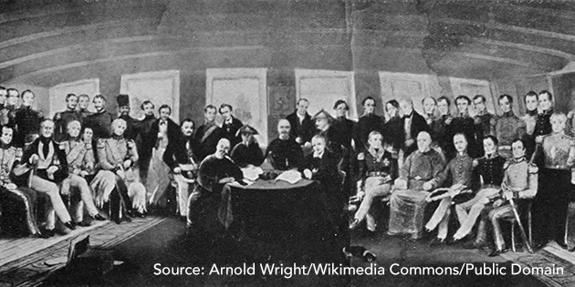
THE TREATY OF NANJING, 1842

Slide 22
OPIUM WARS
The Second Opium War
After repeatedly falling short of British expectations of Treaty enforcement, a second Opium War broke out in 1856 and ended in 1860.
The British, again, won this war and forced on China a new round of unequal treaties, indemnities, and the opening of 11 more treaty ports. This also led to increased Christian missionary work and legalization of the opium trade.

Slide 23
THE END
Ms. Paget, West Vancouver Secondary

